Slide 1
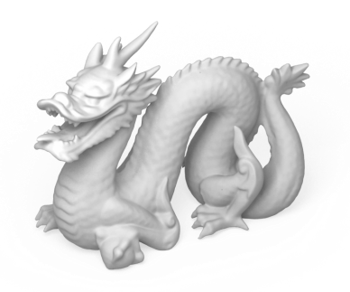
Detail-Replicating Shape Stretching
M.Sc. Thesis Defense
Ibraheem A. Alhashim
Notes:
Good morning (and evening)
- Present my Master Thesis
- A mesh stretching tool with surface details replication

Slide 2
Outline
Introduction
Problem Description
Related Work
Our Algorithm
Results
Conclusion & Future Work
Notes:
Start with…
1) Intro: talk a bit about motivation for this work
2) Problem: describe the problem, the challenges, and goals
3) Related: briefly go over recent deformation methods
4) Algo: detail our algorithm and discuss some of the limitations
5) Results: show a variety of examples made with our method
6) Conc: And finally conclude with a summary and present some ideas for future work

Slide 3
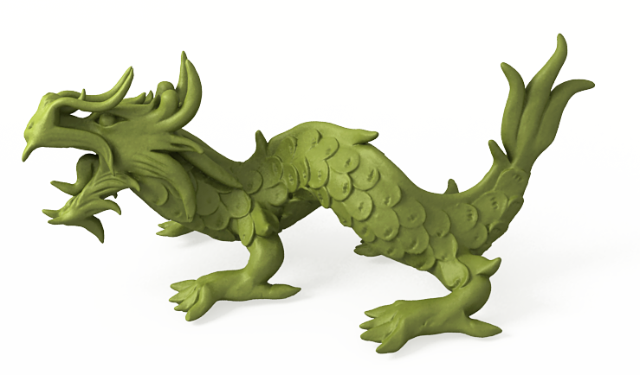
Introduction
Mesh deformation & Editing
Advancement computing and laser scanners allow for highly detailed 3D shapes
Manual modifications are time consuming
Editing methods that are effective & automatic
Recent works focus on structure & detail preservation
Notes:
Nowadays, we deal with large, detailed models
Manual deformations are challenging
We are looking for methods
recent work focus on detail and structure preservation

Slide 4
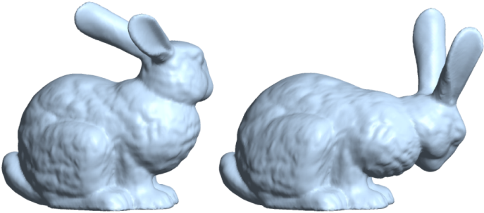
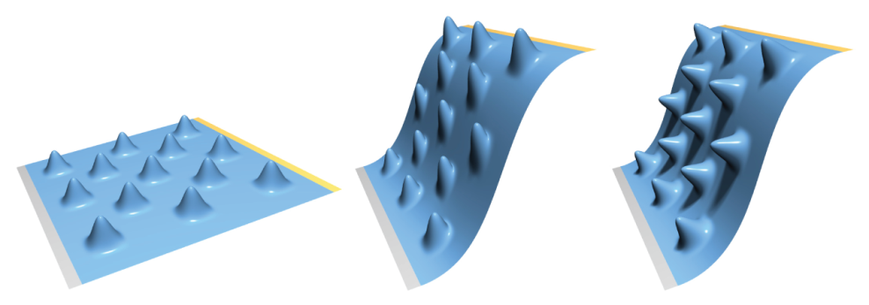
Introduction
Detail preservation
Under small deformations
Translation, bending, twisting
However, stretching is not applicable
Notes:
State of the art mesh deformations can preserve details under small rigid transformations
However, stretching is not applicable

Slide 5
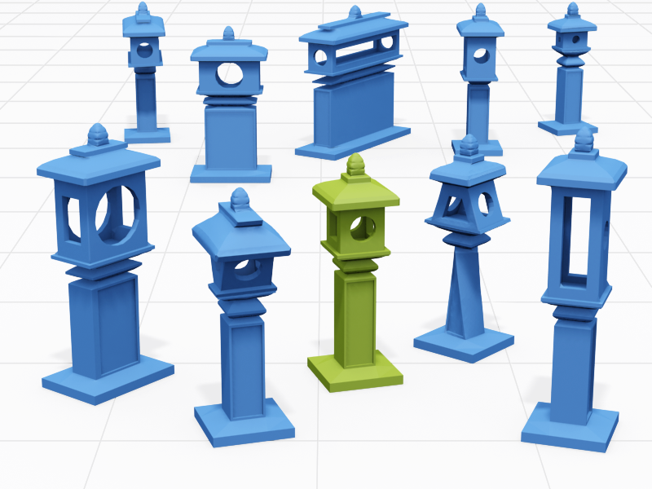
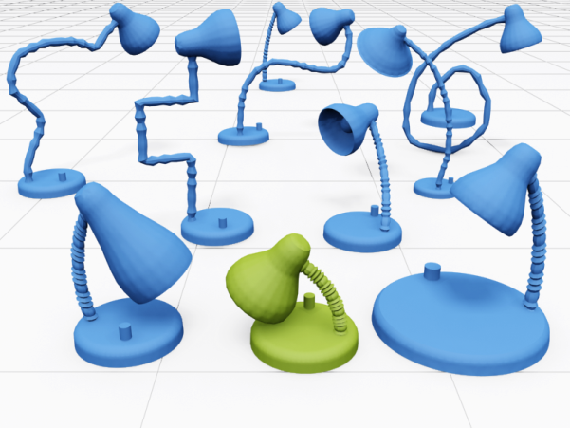
Introduction
Structure preservation
Scaling and stretching
Non-homogeneous resizing, iWIRES
Notes:
Other methods preserve the ‘Structure’ or high-level properties of the shape
smaller details might be distorted (lamp)

Slide 6
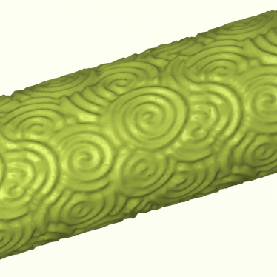
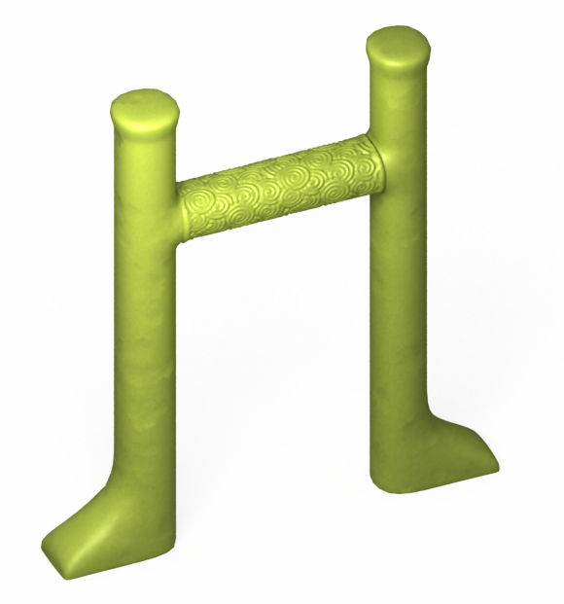
Introduction
What about surface details?
?
Notes:
- None of these methods consider the distortions when performing stretching of meshes with surface details
- In this thesis, we would like to explore this problem

Slide 7
Outline
Introduction
Problem Description
Related Work
Our Algorithm
Results
Conclusion & Future Work
Notes:
We now describe the problem, its challenges, and some of the goals we are trying to achieve

Slide 8
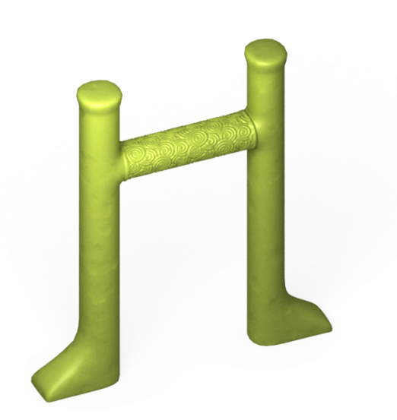
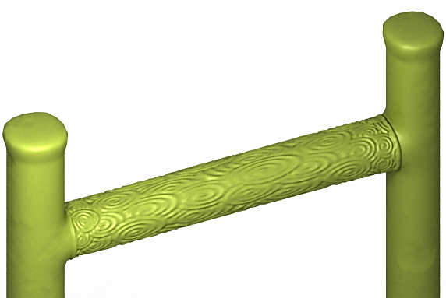
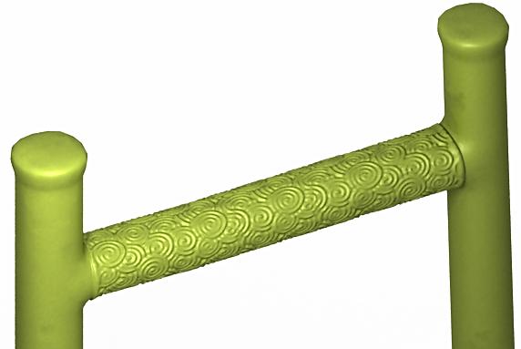
Problem Description
Stretching shapes with surface details
Input shape
FFD (interpolate)
Detail-replicating stretching
Notes:
Given the following input shape
When we apply a stretch
FFD, such as embedding the shape in a deformation grid, would distort the details
The more intuitive behavior we might expect is to be able to stretch the mesh and retain the similar look of that of the source’s surface details

Slide 9
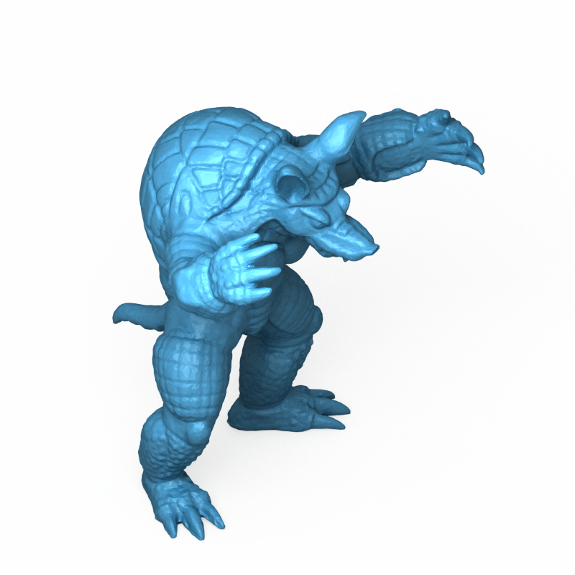
Problem Description
Challenges
Identifying & extracting surface details
Boundaries
Generality
Larger search space in 3D
Artifacts of synthesis
Visible seams
Repetitive appearance
Notes:
Some of the challenges are
Defining what are the details and what regions do they cover?
Unlike 2D : no color information, also work on surfaces rather than on a plane
Need to be careful about the synthesis

Slide 10
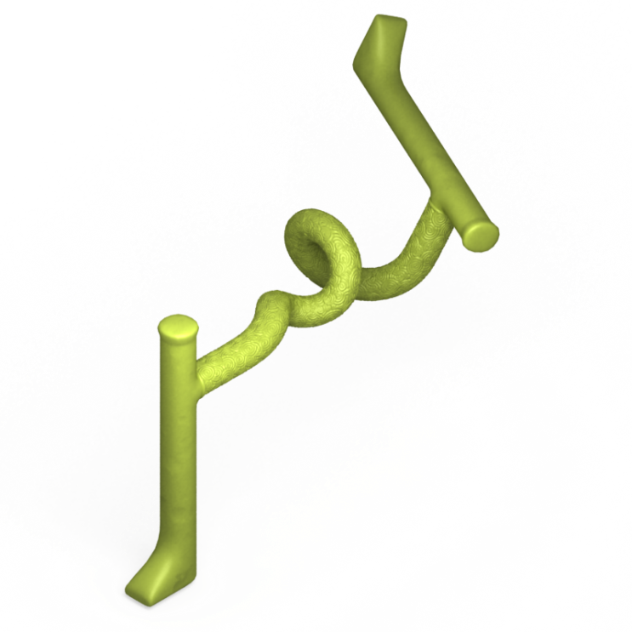
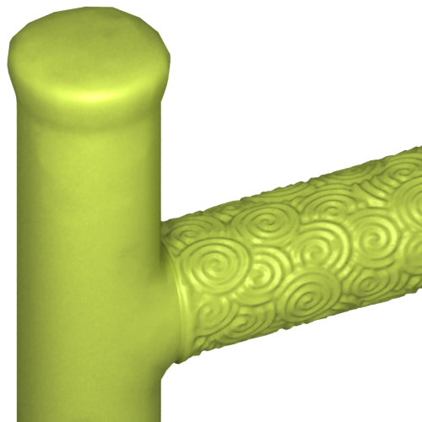
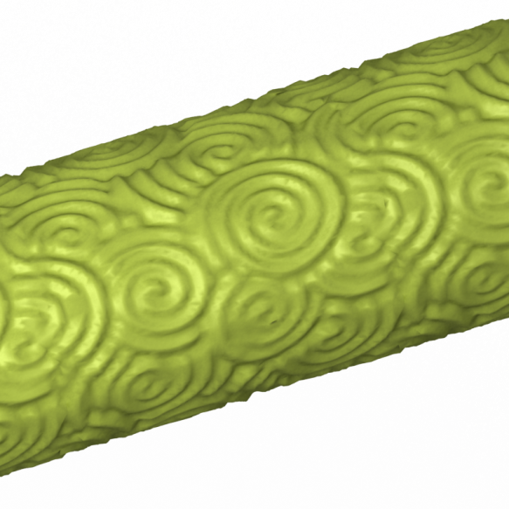
Problem Description
Goals
Ensure continuity
Preserve shape & frequency of details
Artistic control
Efficiency
Notes:
When performing a stretching operation we would like to:
- ensure…

Slide 11
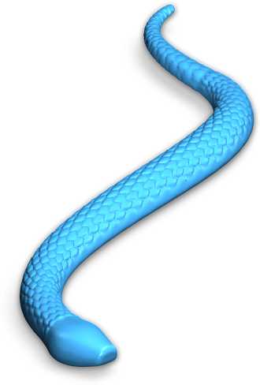
Problem Statement
Given a 3D shape containing surface details, we would like to apply stretching operations while maintaining the appearance of preserved surface details
stretch
Notes:
…. as stretching will clearly distort surface details

Slide 12
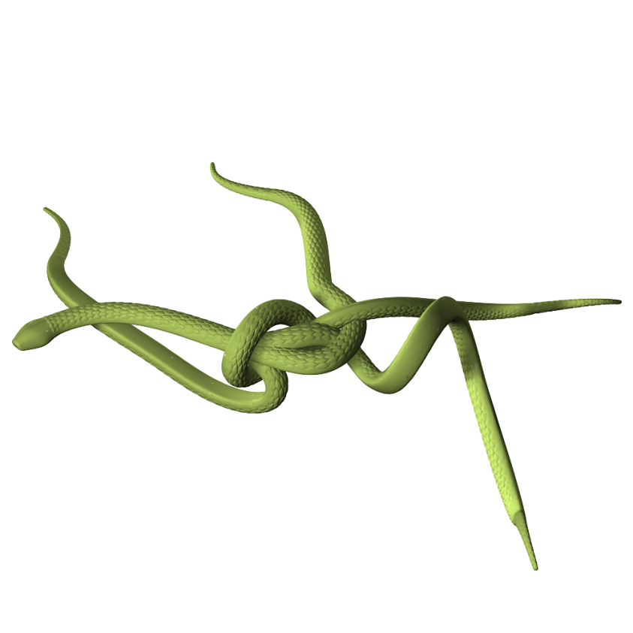
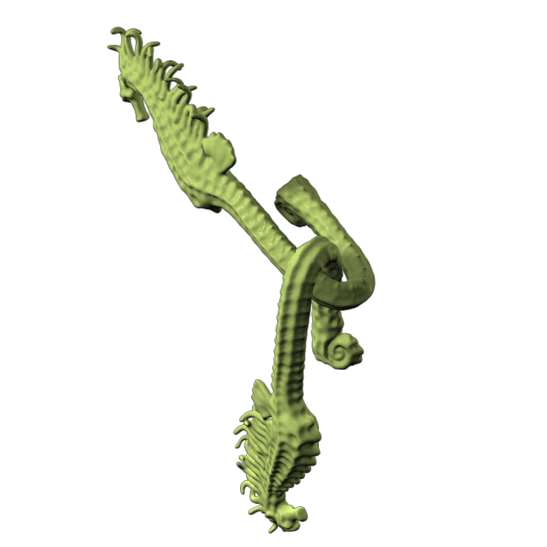
Applications
Shape variation
Change style by elongating part
Easily resize models from different sources
Save time when populating a scene
Add randomness to parts of objects / characters
Notes:
These are some shapes stretched with our method.
Snake from shorter snake.
Seahorse tale

Slide 13
Outline
Introduction
Problem Description
Related Work
Our Algorithm
Results
Conclusion & Future Work
Notes:
We now go over some of the related work on the topic of deformation and detail replication

Slide 14
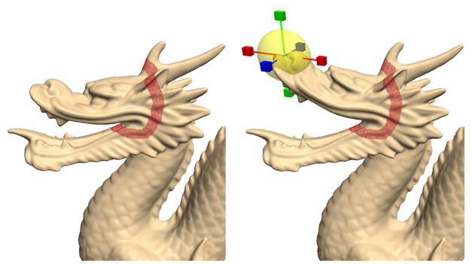
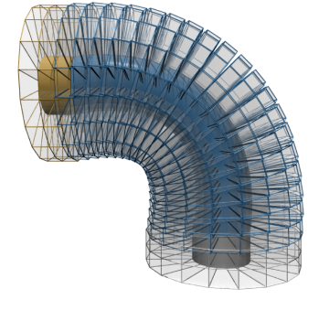
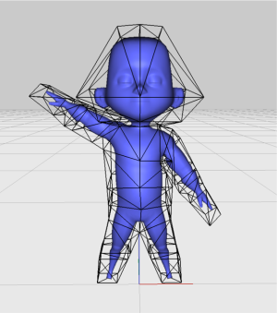
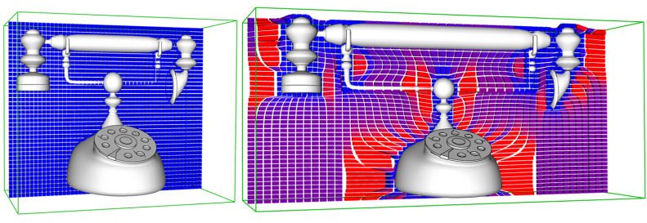
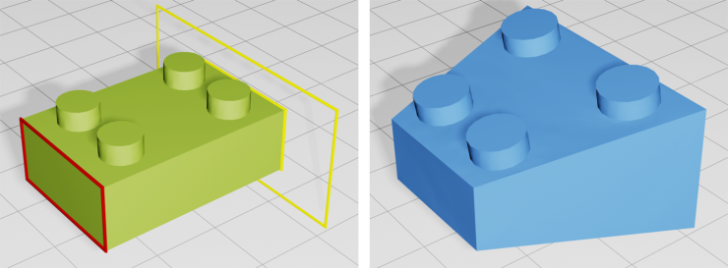
Introduction
3D Deformations exhibition
Sorkine et al. (SGP04)
PriMo (SGP06)
Harmonic coordinates (SIG07)
Non-homogeneous Resizing (SIG-ASIA08)
iWIRES (SIG09)
Notes:
Recent mesh deformations methods that preserve details under simple transformations include:
Laplacian Surface Editing: encoding each vertex relative to its neighbourhood, made it invariant to local transformations
PriMo: embedded inside volumetric prisms, which are joined through non-linear elastic forces
Harmonic: generalize barycentric coordinates inside a cage (from Pixar)
The last two methods allow for stretching operations that preserve structure
Non-homogeneous resizing: compute vulnerability map of mesh on a grid
iWIRES: analysize sharp edges, create wires and relations, use for constrains in mesh deformation methods

Slide 15
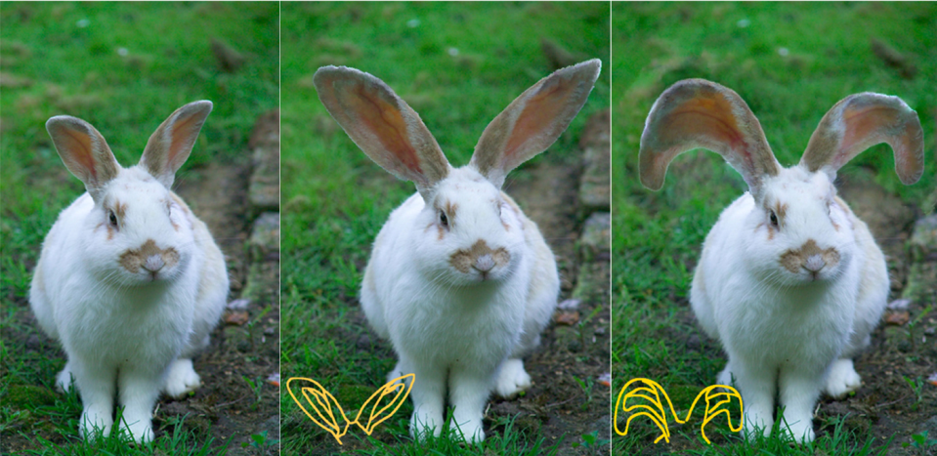
Related Work
2D detail preservation
Fang and Hart (SIG07)
Define feature curves on image
Compute curvilinear coordinates around the curves
Deform the regions exactly on the curves
Adapt GraphCut texture synthesis [Kwatra03] to fill missing area
Notes:
In the 2D, Fang and Hart presented a method that preserves details when stretching and bending

Slide 16
Related Work
Space-deformation and structure preservation
Non-homogeneous resizing of complex shapes (SIGASIA08)
Compute vulnerability map of mesh on a grid
Per-face metric of slippage and normal curvature
Space-deformations are applied with the appropriate weights
Notes:
As for space-deformation and structure preservation…

Slide 17
Related Work
Applying surface details
Anisotropic Resizing of Model with Geometric Textures (SPM09)
Extension of “Non-homogeneous resizing”
Scale along grid axis
Notes:
This work reapplies the geometric textures after the structure preserving scaling
(Clustering textured region by adopting a mean shift technique - Descriptor used: vertex coordinates + local principal curvatures)

Slide 18
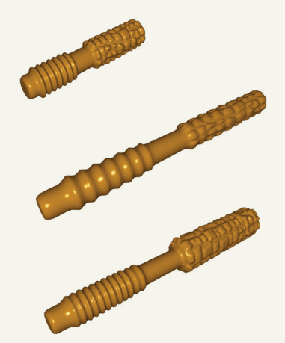
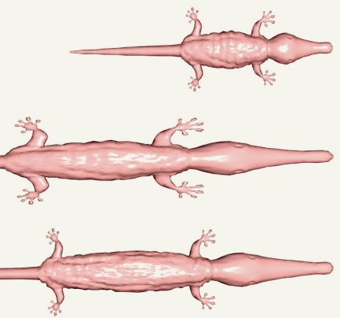
Related Work
Anisotropic Resizing of Model with Geometric Textures
Input
FFD
Chen09

Slide 19
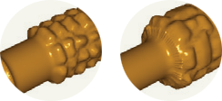
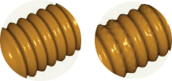
Related Work
Anisotropic Resizing of Model with Geometric Textures
Limitations of this method:
Height fields textures only
Require surface resampling
Quality
Efficiency
Minutes (vs. milliseconds in our method)
Loss of continuity
Distorted details

Slide 20
Outline
Introduction
Problem Description
Related Work
Our Algorithm
Results
Conclusion & Future Work
Notes:
Next, we go over the steps of our algorithm

Slide 21
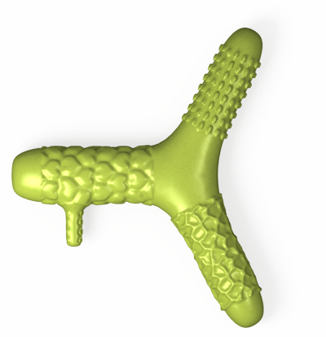
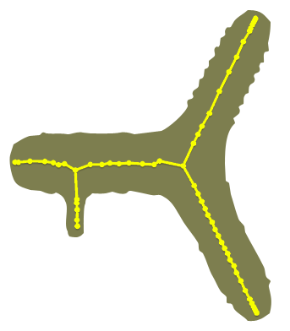
Assumptions
We are given a curve skeleton of the shape:
Simple curves describing the topology and overall shape
Skeleton extraction by mesh contraction [Au et al. 08]
Stretching is done only in 1D
Notes:
First, assumptions about our input and the type of editing operations

Slide 22
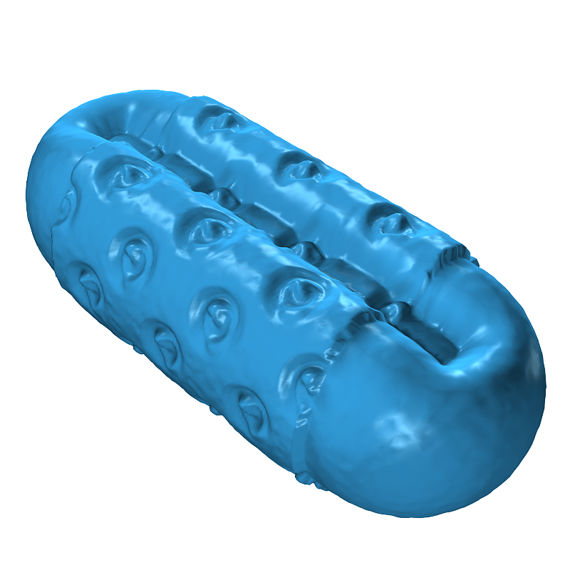
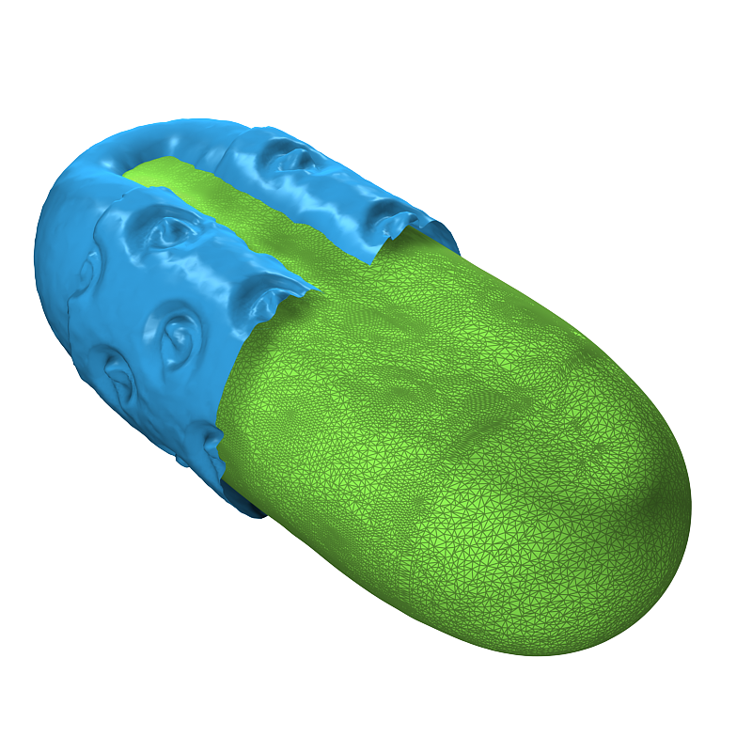
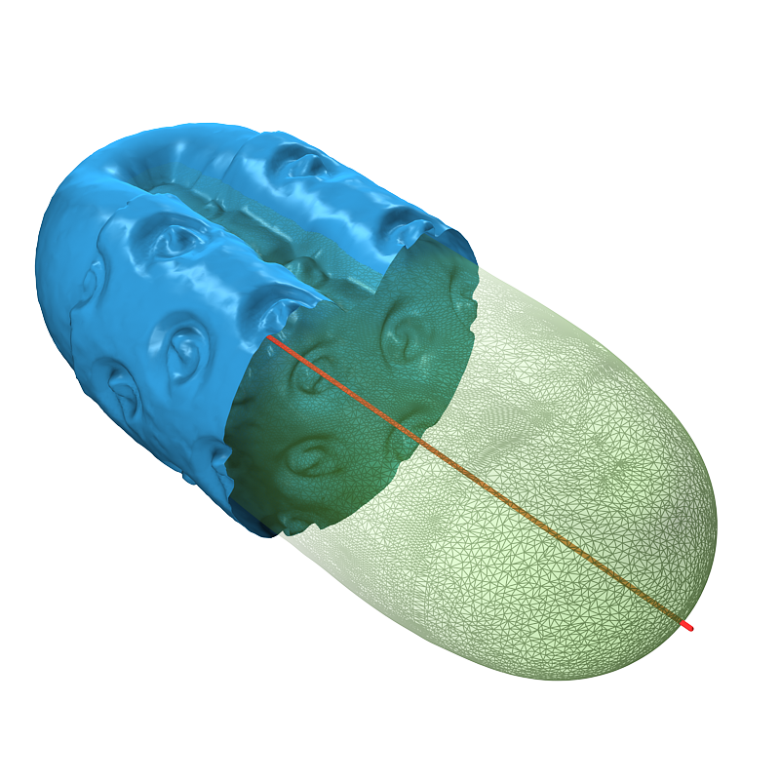
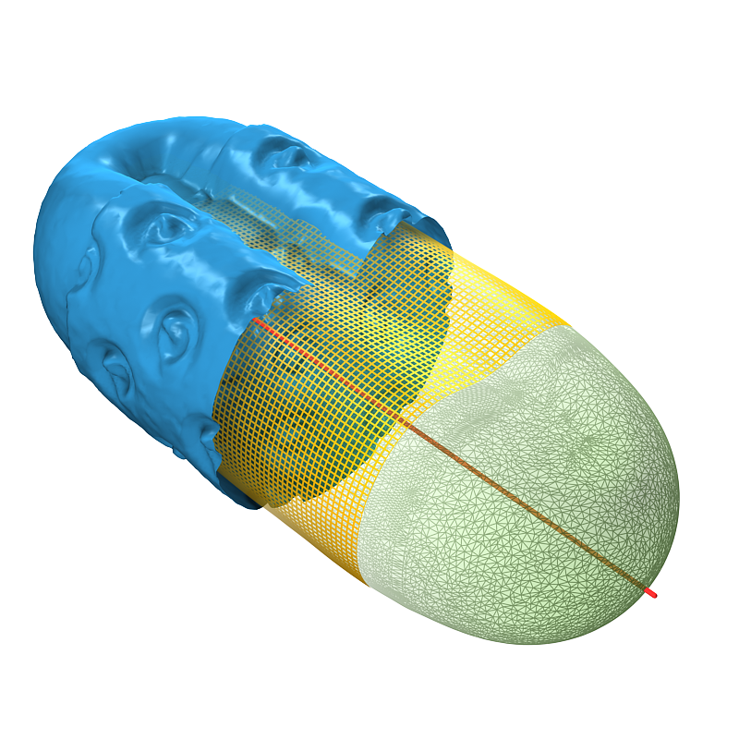
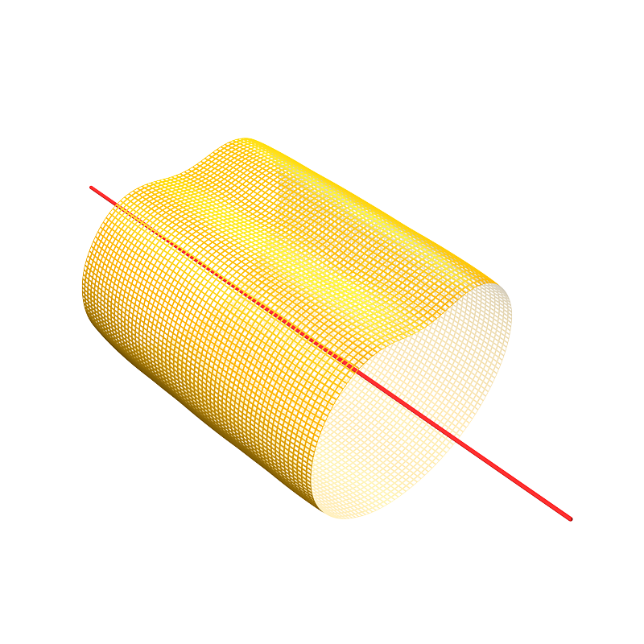
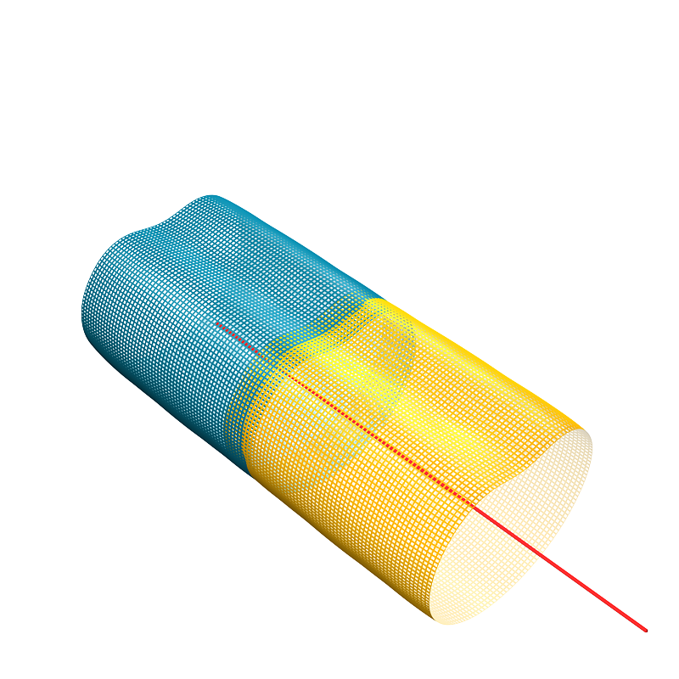
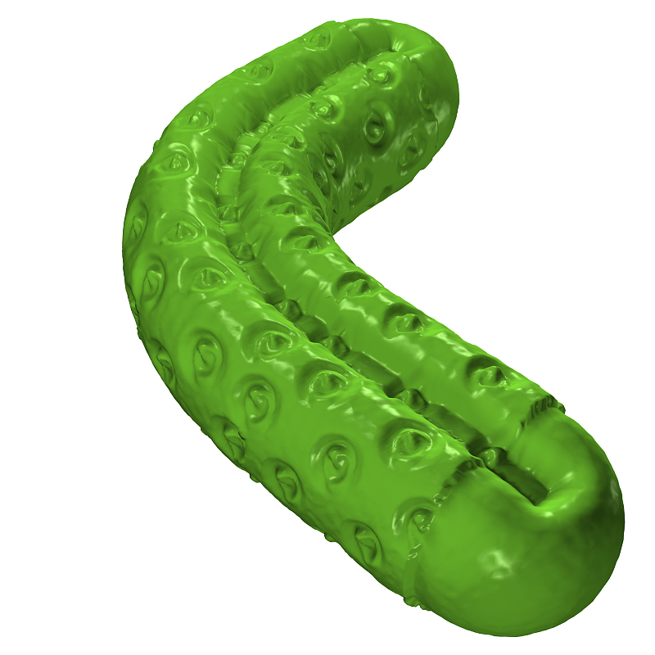
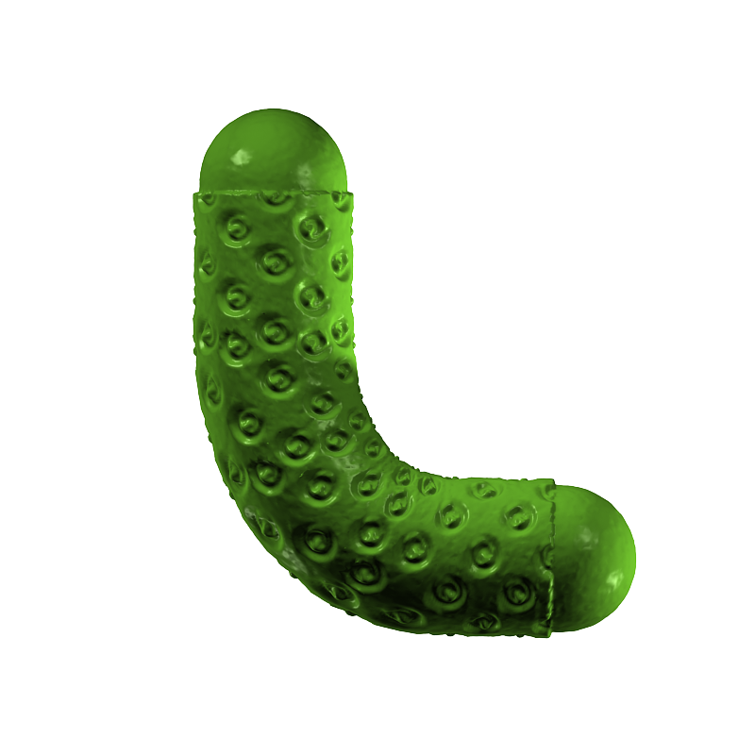
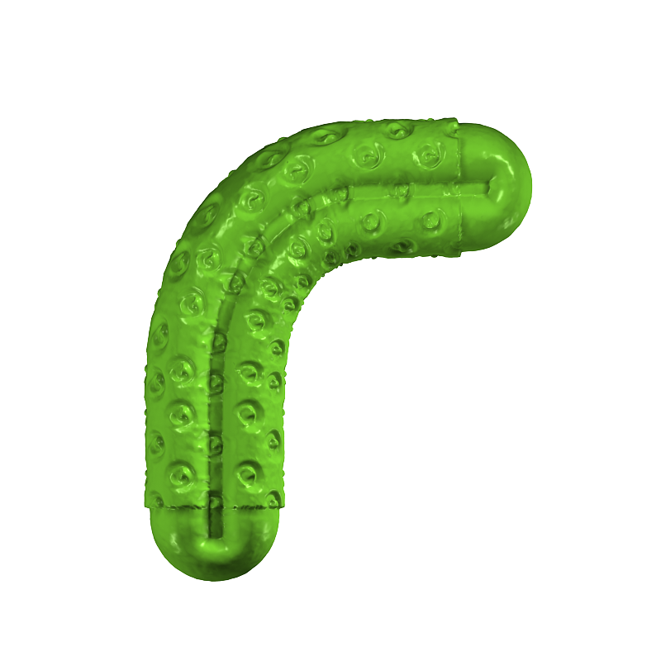
Overview
Visual overview
Input
Compute base (smoothing)
Sweep along curve skeleton
Generate grid
Project from and onto grid
Extend along extension curve
Reconstruct geometry
Notes:
Here we present a visual overview of our algorithim

Slide 23
Overview
Algorithm steps
We perform detail replication during 1D stretching with the following steps:
Approximate details as a 2D image I
Synthesize Iʹ - a user specified extension of I
Construct geometry following Iʹ
Combine into a single surface
Notes:
Formally,

Slide 24
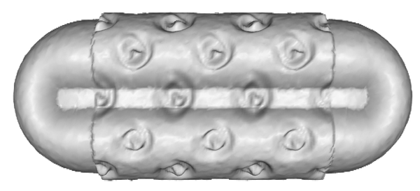
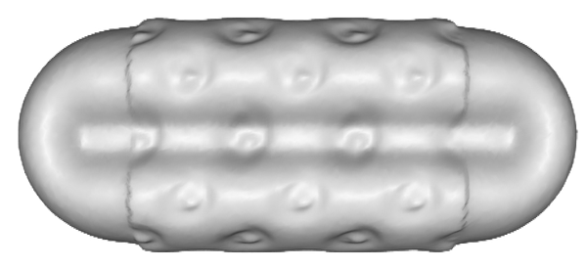
Base Extraction
Details = difference between the input mesh and the ‘base mesh’
Base = smoothing high frequency details
Mean curvature flow [Desburn99]
Step size λdt is user specified
Notes:
Now we look into each step in more details:

Slide 25
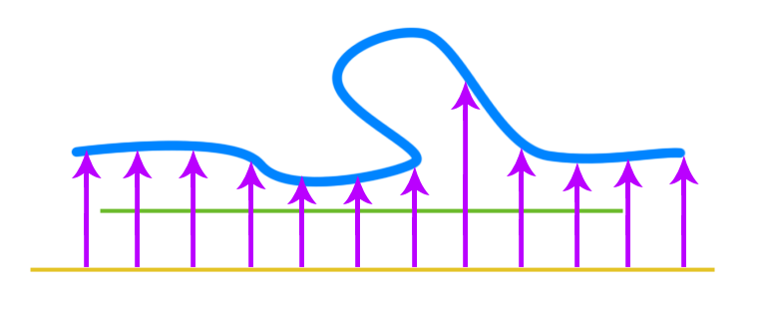
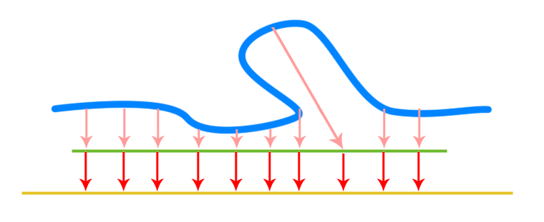
Grid Construction
Grid approximates the shape of the base mesh
Project grid onto source
approximate height map image
Map surface to a regular grid
Projecting base vertices onto grid cells
Reconstruction: cells reference frame
Limitation: parts with topology similar to a cylinder

Slide 26
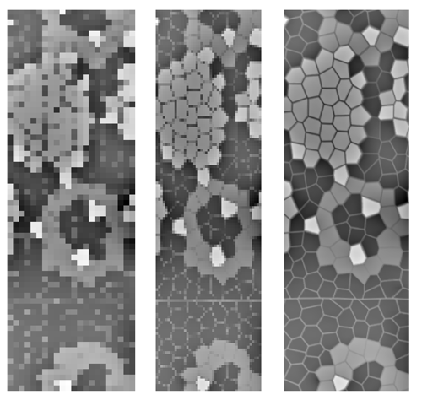
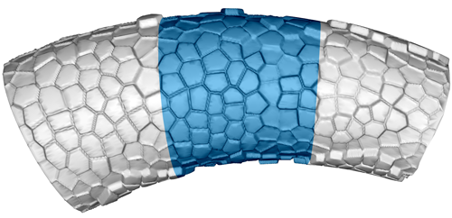
Grid Construction
Grid resolution h depends on texture
Detailed textures require higher resolution
h =
70
140
512
Grid range

Slide 27
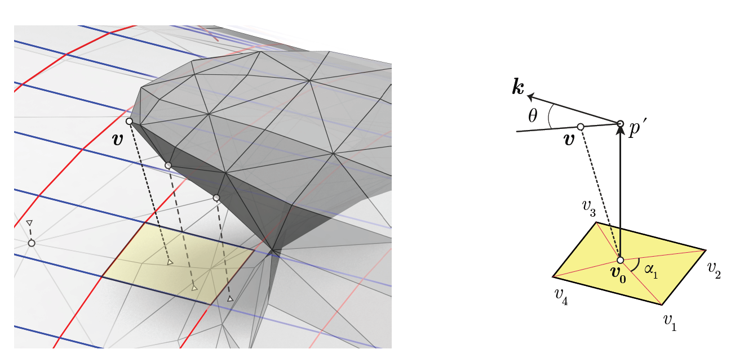
Texture Representation
Encoding the details
Project base vertices onto grid
Encode source vertex position based on grid cell
Handle more complex details

Slide 28
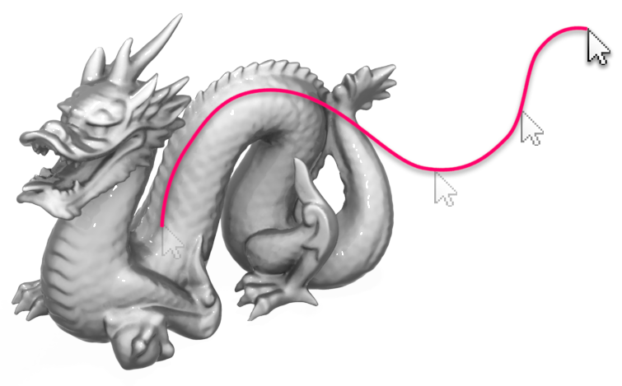
Synthesizing Extensions
The user draws a curve E
Project 2D path onto plane passing through start of selected region
Plane is then aligned with skeleton
Length of E signifies amount of extension

Slide 29
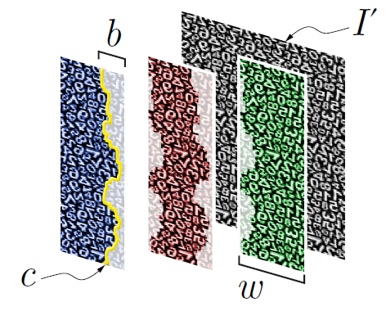
Synthesizing Extensions
Patch based texture synthesis
Along one direction
Simply tile with an overlap b pixels
b depends on the texture
Find best cut in the overlap
Input

Slide 30
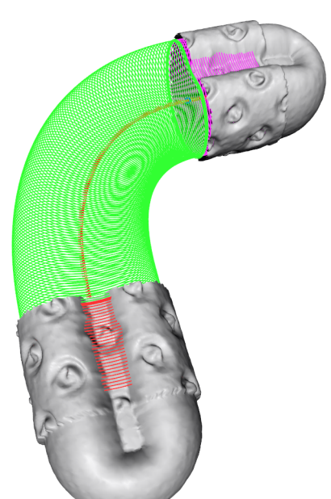
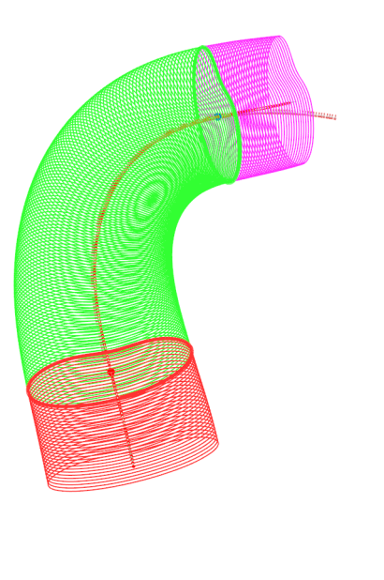
Geometry Reconstruction
Extend the grid to fit the curve E
Combine with source mesh

Slide 31
Geometry Reconstruction
Cross-sections of extended grid part
Interpolation
Match the source
Interpolate
Tile
Interpolate
Tile

Slide 32
Stitching Patches
Fill discontinuity between reconstructed patches
Avoid creating any visible artifacts
stitching

Slide 33
Stitching Patches
Surface reconstruction is a overkill
We simply stitch the boundaries between adjacent patches
Greedy method, minimum edge lengths
Try to avoid self-intersections
Limitation: no guarantee that the end result is 2-manifold

Slide 34
Stitching Patches
illustrations
Per-boundary conditions

Slide 35
Adding Variation*
Optional step
To avoid a repetitive look we can add variation on the grid’s cross-sections
More suited for organic shapes

Slide 36
Parameters
User specified parameters
Depending on the texture
λdt Amount of smoothing
h Grid resolution
b Overlap between patches
Flexible (high, med, low)
Future work: automate some paramaters

Slide 37
Outline
Introduction
Problem Description
Related Work
Our Algorithm
Results
Conclusion & Future Work

Slide 38
Results
Implementation
Using C++ and OpenGL
Qt for GUI
3.0 GHz AMD Phenom II – quad core

Slide 39
Results
Stanford Dragon
2.19 seconds
1647 vertices

Slide 40
Results
Dragons and Dino
0.62 s
301 vertices
1.82 s
3032 vertices

Slide 41
Results
1.67 s
1549 vertices

Slide 42
Results
Knot
3.83 s
9380 vertices

Slide 43
Results
Twisted pattern and Handles
1.13 s
5529 vertices
3.39 s
15272 vertices

Slide 44
Results
Necklace
4.6 s
3291 vertices (result 80000)

Slide 45
Limitations
Curve skeletons suitable for 1D stretching
Spheres, sheets
Texture synthesis failure cases
Grid approximations = distortions
Accuracy vs. speed
Stitching process is very simple
Sometimes small artifacts appear on the seam area

Slide 46
Limitations
Sharp features
Future work: analysis during texture synthesis

Slide 47
Limitations
Approximations of smooth details
Complex base (handle)

Slide 48
Outline
Introduction
Problem Description
Related Work
Our Algorithm
Results
Conclusion & Future Work

Slide 49
Conclusion
In this thesis
Presented an intuitive mesh editing tool
1D stretching
Based on replicating details from the source mesh
Separating large from small details
With grid
Visually pleasing results, efficient and interactive
This work is a step to a more general ‘detail aware’ shape stretching method

Slide 50
Future Work
Avoid user selection
Analyzing the different details on the surface and segmenting them
Automate some of the parameters (statistically)
General grids
Spheres, sheets, patches with arbitrary boundaries
Incorporate symmetry relation between parts
Robust boundary stitching
Integrate with other deformation methods

Slide 51
Acknowledgments
Thanks to
Dr. Richard Zhang & members of the supervisory committee
Fellow students at the GrUVi lab
Sponsoring agency (MOHE)

Slide 52
Detail-Replicating Shape Stretching
Thank you for listening
Questions?
Source code & video available at:
http://code.google.com/p/extend-mesh/

Slide 53
Appendix

Slide 54
Appendix

Slide 55
Appendix

