Slide 1
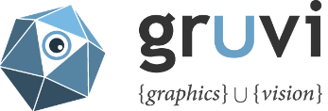
Topology-Varying Shape Matching and Modeling
Ibraheem Alhashim
PhD Thesis Defense
11:00 a.m. - November 10th, 2015 - TASC1 9204 East
Notes:
Good morning everyone and good evening to those joining us remotely
Today I’ll summarize the work I have done during my PhD program on “Topology-Varying Shape Matching and Modeling”

Slide 2
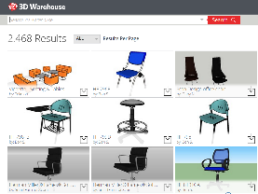
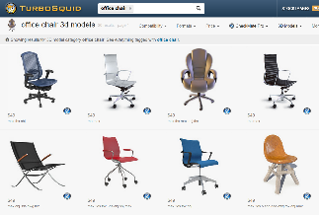
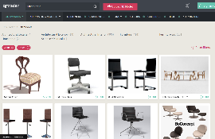
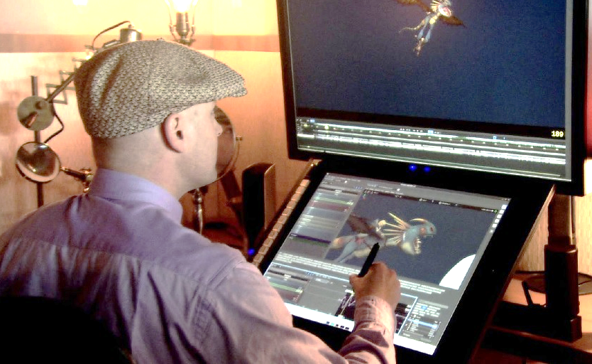
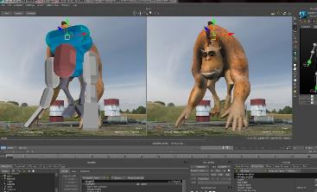
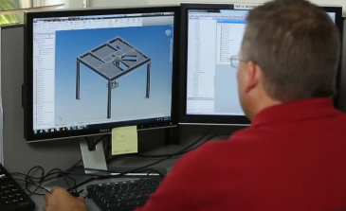
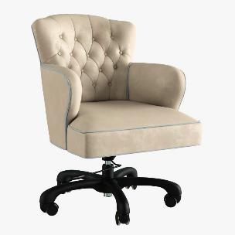
Motivation
3D modeling is hard!
Model reuse is easy and fast
Notes:
[CLICK!] 3D modeling is hard, especially for man-made objects with complex structure. Often requiring designers and artists years to master the toolsets
The reuse of existing assets, can simplify the process and is useful for rapid prototyping of ideas for both novice and professional users

Slide 3
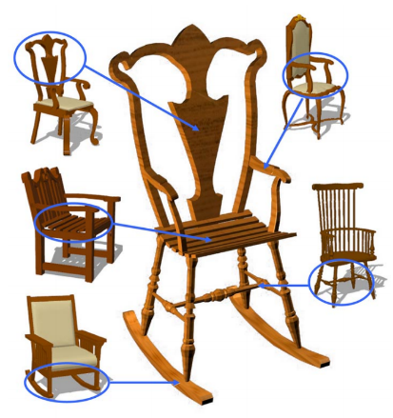
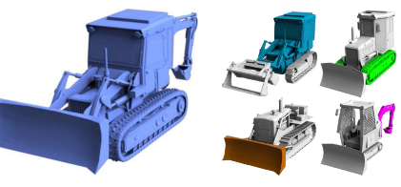
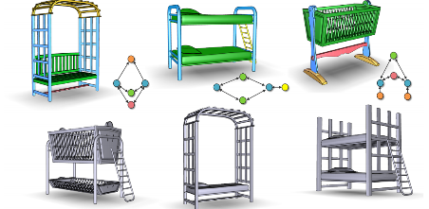
Motivation
Previous methods recombine or shuffle
Key problem: finding compatible parts or combinations
[Jain12]
[Kalogerakis 12]
[Funkhouser04]
[Xu12]
[Zheng13]
Notes:
Past efforts on the automation of modeling from examples involve a recombination or shuffling of parts with the key problem being finding the set of compatible parts
However, the expected output from these methods is limited

Slide 4
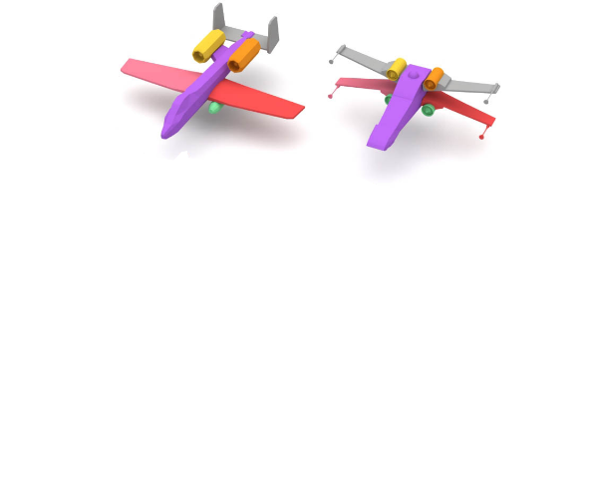
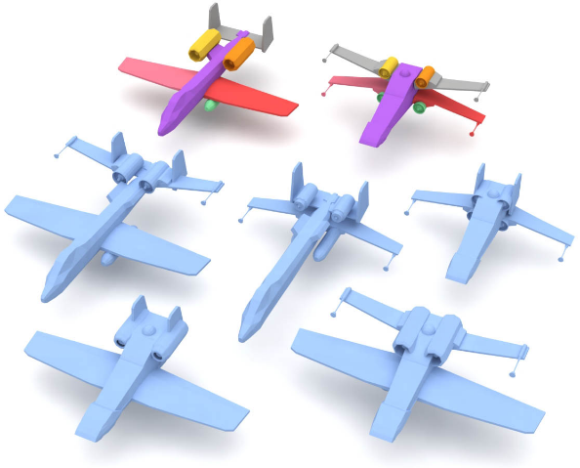
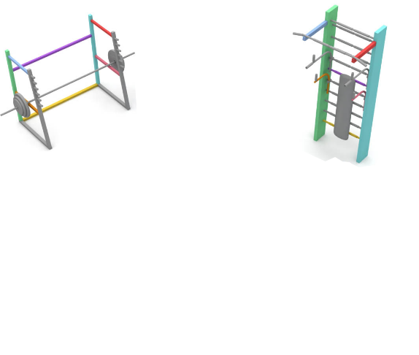
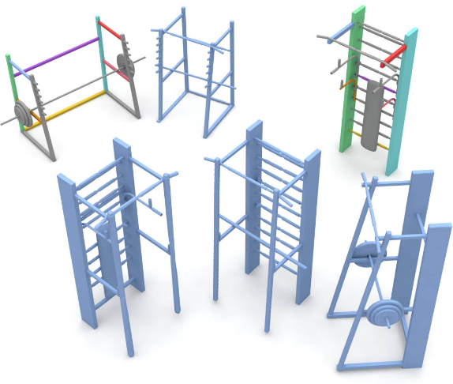
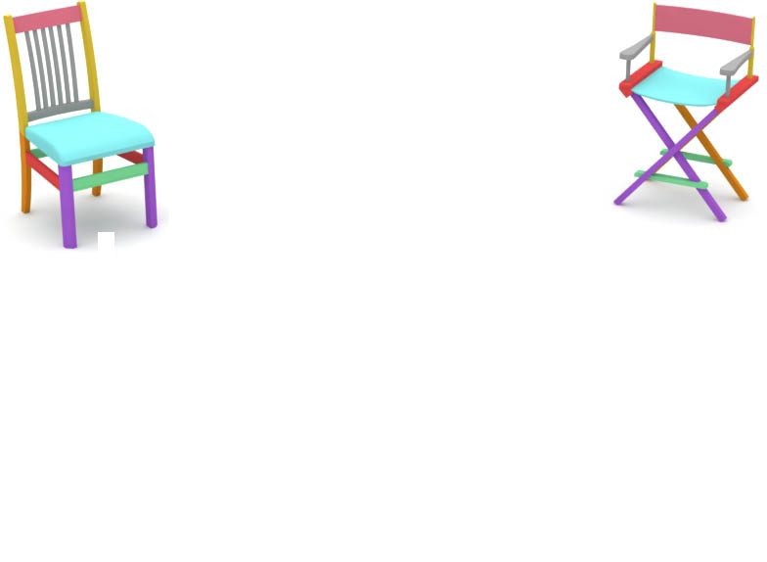
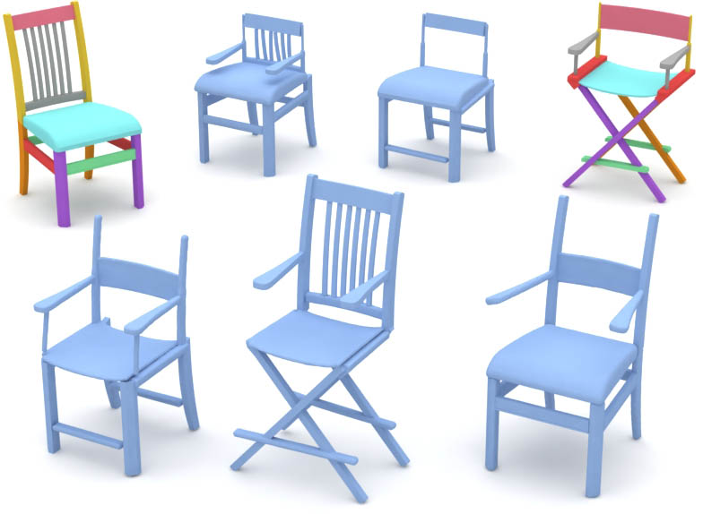
Motivation
Continuous blending can produce richer variety!
Notes:
We can do a lot more with a small number of shapes if we compute a continuous blending of 3D shape pairs

Slide 5
Challenges
Computing a continuous interpolation of two man-made 3D shapes
Solve two challenging problems
1
Continuous mapping of topologically different shapes
Quality depends on finding precise & meaningful matches
Matching
2
How to perform interpolation and changes in topology
No existing solutions suitable for man-made objects
Blending
Notes:
In this thesis, we are interested in the problem of computing a continuous interpolation of two 3D man-made shapes
In order to do so, we need to solve two related problems:
(1) First a matching problem, we need to have a continuous mapping between all parts of the shape
However, for man-made shapes we would need to find a matching for shapes that are structurally different, where semantically similar parts can connect in different ways and, where some parts do not have meaningful counterparts. This is a highly challenging problem
Furthermore, the quality of the interpolated shapes depends on the precision and meaningfulness of the matching
(2) Second the shape blending problem, Even when given a good correspondence, we need to have a mechanism that produces plausible in-betweens and also supports dynamic changes in the shape's topology
However, no existing solution is suitable for man-made objects

Slide 6
Contributions
Correspondence algorithm
Using a deformation-driven correspondence search
Fine-grained matching of shapes with different geometry and structure
Outperforms state-of-the-art on complex objects
Topology-varying shape blending
The first structure-aware, continuous shape blending
Much larger variability than existing methods
Topology-altering operations: splitting, merging, growing, shrinking
Shape creation tools via continuous interpolation
Notes:
In this thesis, we focus on finding approximate solutions to these problems:
(1) First, we solve the correspondence problem with an algorithm that matches parts in a deformation-driven search. Our method computes a fine-grained matching of shapes with different geometry and structure. Our evaluation show that it also outperforms state-of-the-art on a set of complex 3D shapes
(2) Second, We propose the first method that generates continuous plausible variations of 3D shapes having different topology. Having a continuous blending enables a larger space of possible in-between. To handle differences in topology, we define different topology changing operations, such as splitting and merging and growing, and execute them as necessary
(3) Lastly, we present a set of shape creation tools that demonstrates the utility of our proposed shape matching and blending

Slide 7
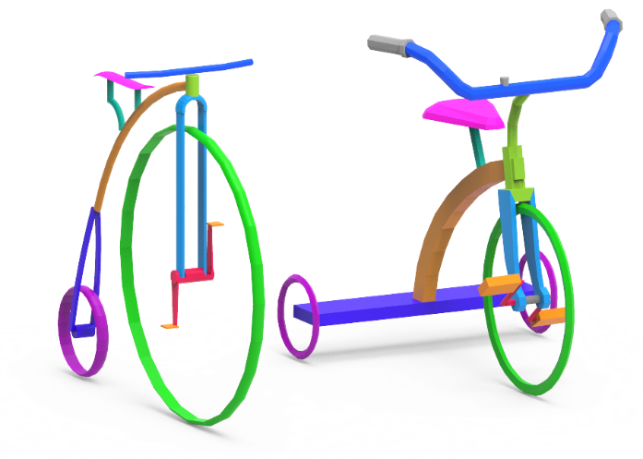
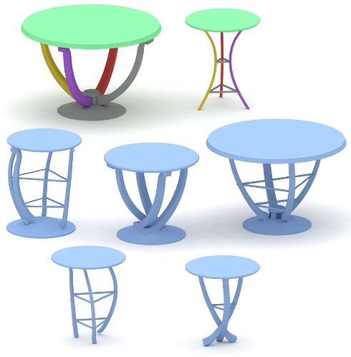
Overview
Shape Correspondence
Blending + tools
Conclusion & Future Work
Notes:
In the upcoming parts:
(1) First, I’ll briefly describe our shape correspondence method, and evaluate its strengths and weakness
(2) Second, I'll present an overview of our shape blending algorithm, then demonstrate its use in a modeling system
(2) And I'll end with concluding remarks and a brief discussion on different avenues for future work

Slide 8
Chapter. 3
Corresponding Topologically Different Shapes
Notes:
Now we take a look at the first key contribution: computing a correspondence between topologically different shapes

Slide 9
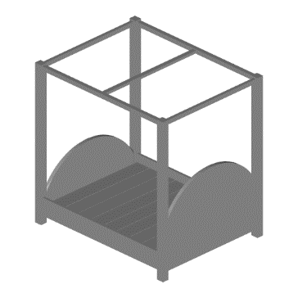
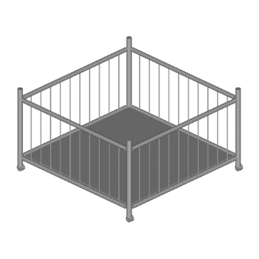
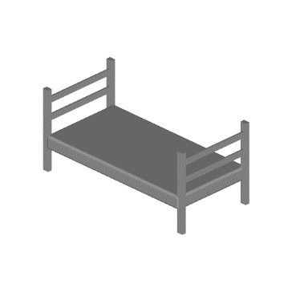
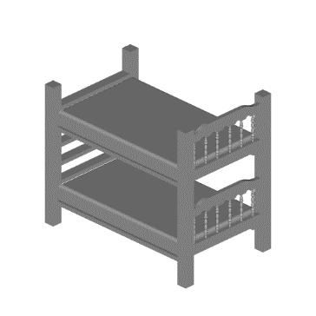
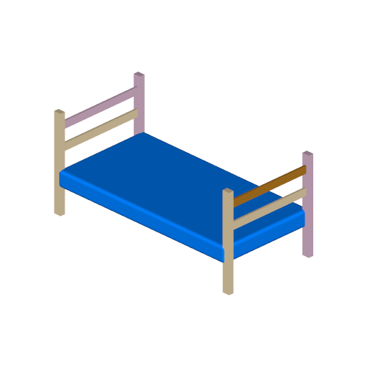
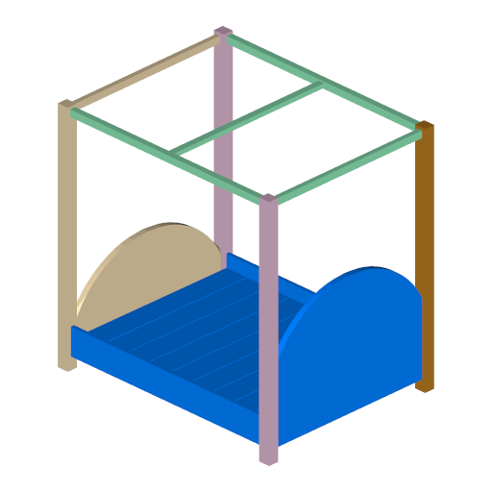
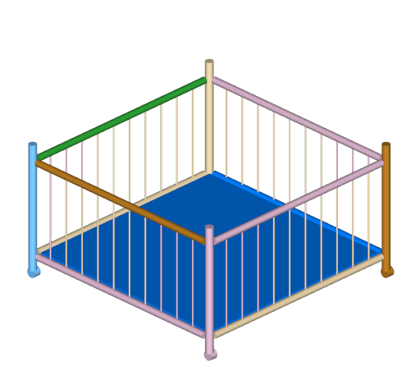
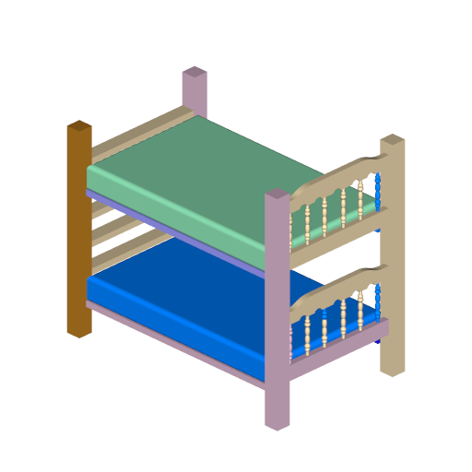
Previous Works
Rigid alignment not sufficient for diverse shapes
[Golovinskiy & Funkhouser 08]
Notes:
A straightforward correspondence can relay on a reasonable alignment and a greedy assignment
This however, is not sufficient for the diverse shapes found in real-world data

Slide 10
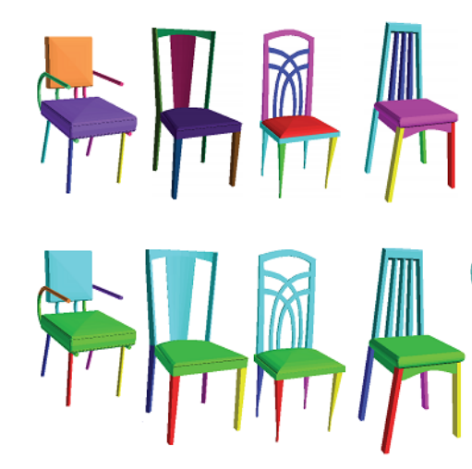
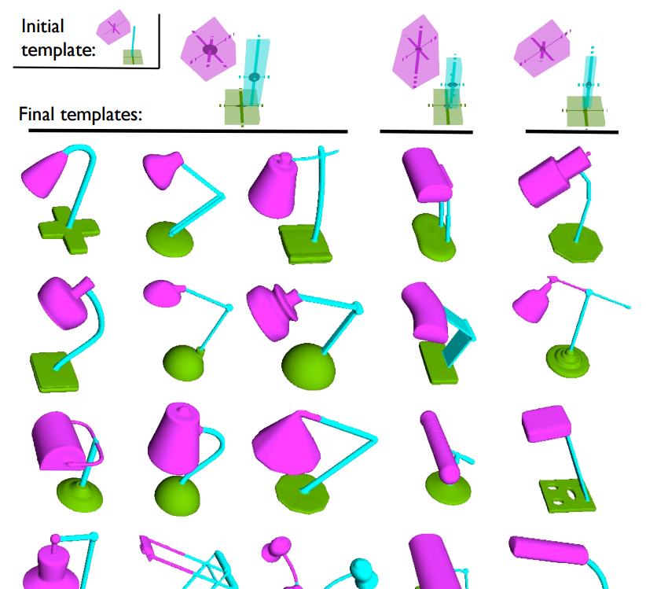
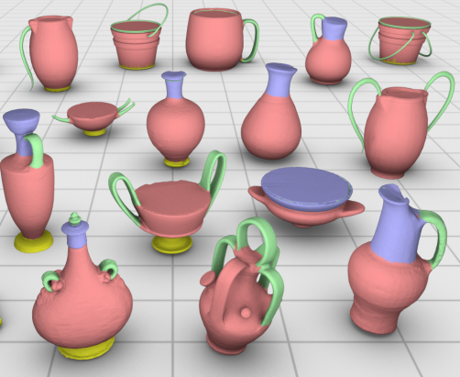
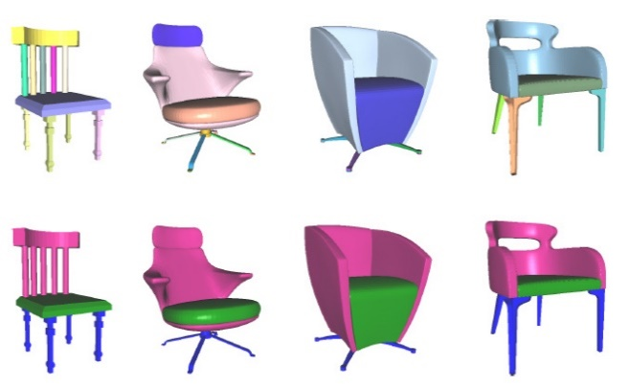
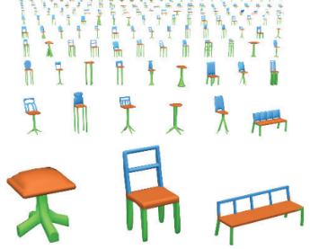
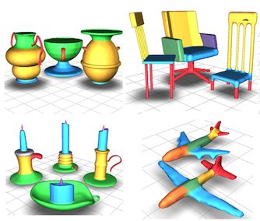
Previous Works
For man-made objects, recent focus is on co-analysis
Coarse results
Forced correspondence
Set of shapes
[Golovinskiy & Funkhouser 08]
[Sidi et al. 11]
[Kim et al. 13]
[Zheng et al. 14]
[Huang et al. 14]
[Laga et al. 14]
Notes:
For man-made objects, the recent focus is on co-analysis methods where we try to extract consistent matching by looking for geometric or structural commonalities on the set. These methods, however, typically:
result in coarse matches where multiple different parts end up matching to a single region
Also, all parts are forced to belong to a specific grouping or label
Lastly, their performance is proportional to the size of set, making them less ideal for pairs

Slide 11
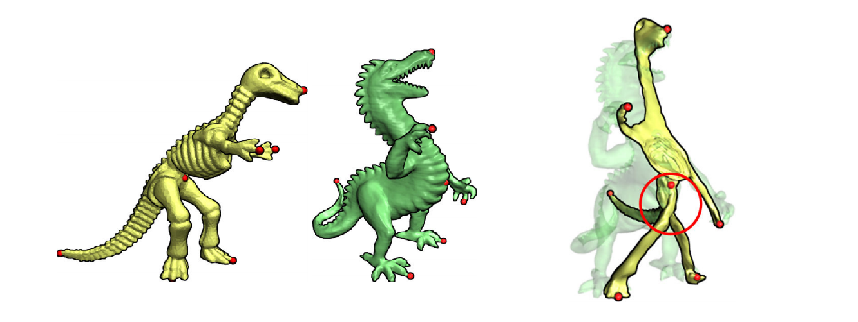
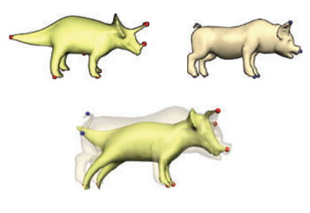
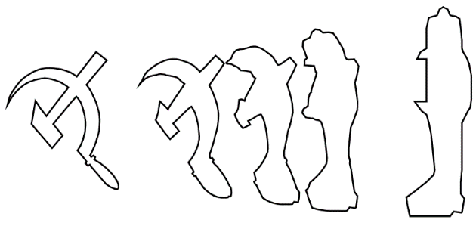
Deformation-Driven Shape Matching
Best matching = minimal self-distortion as we deform one shape to match the other
[Sederberg & Greenwood 92]
[Zhang et al. 08]
Notes:
Another class of methods, more suitable for pairs, are the deformation-driven correspondence methods
These methods build on the assumption that: the best matching is the one that guides a deformation of a shape to match a target with the least overall distortion
{CLICK!} The intuition here is that significant twisting and bending typically indicates that some regions are incorrectly matched

Slide 12
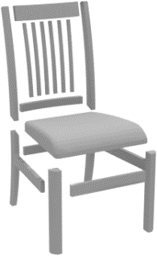
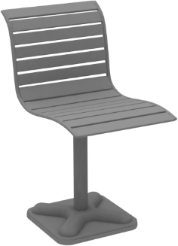
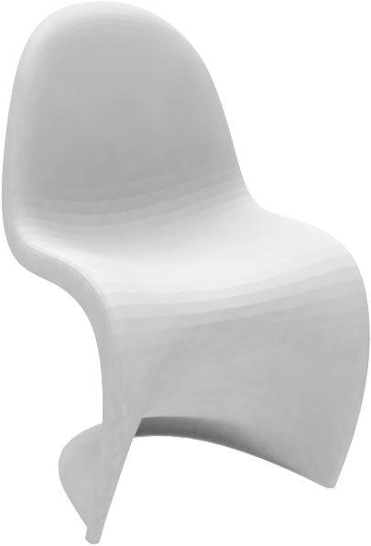
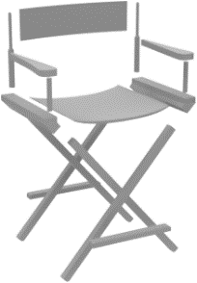
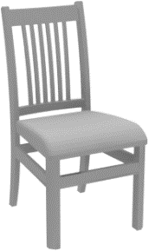
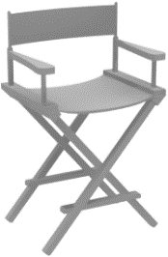
Challenge
How to apply a deformation-driven search to complex man-made shapes?
Many disconnected components
Semantically similar yet very different
Discrepancy in part count & structural relations
Back
Seat
Legs
Notes:
In our work, we are looking at adapting this strategy to matching geometrically and topologically different man-made shapes
There are several challenges to overcome
First, man-made objects are typically made of many disconnected components, we need a deformation model to supports that
Second, we typically find semantically similar parts that are geometrically very different, so we need to be less sensitive to these differences
Third, we need to handle the abundant discrepancy in part count and topology in man-made shapes

Slide 13
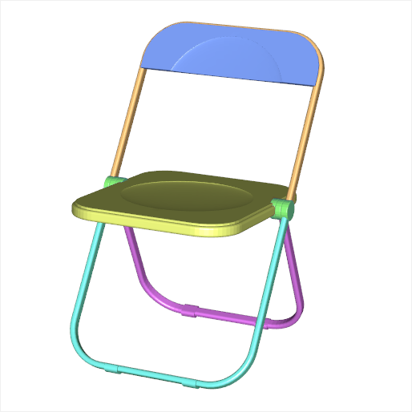
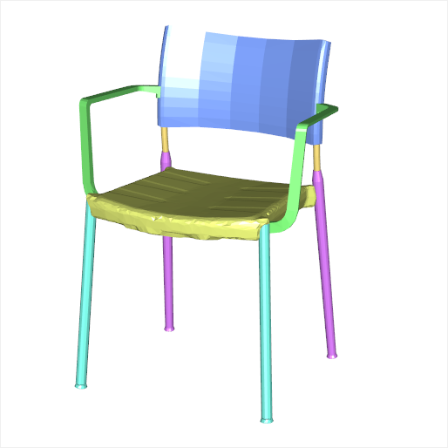
Our Proposal
The GeoTopo transform
Piece-wise continuous part correspondence
Supports topological changes
No prior or fixed number of segments
Works on pairs
Notes:
We address these issues by proposing the “GeoTopo transform”
A deformation-driven, correspondence search, that
Computes piece-wise fine-grained part correspondences
It supports topological changes including part splitting and merging
It does not need any prior information and is not limited to a fixed number of parts
It is also efficient to compute
And it is designed to handle shape pairs

Slide 14
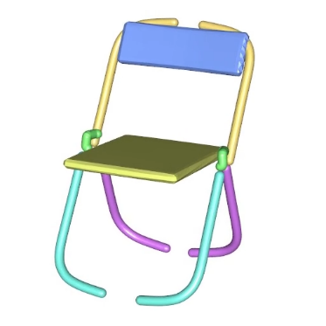
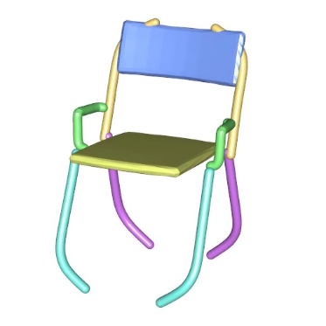
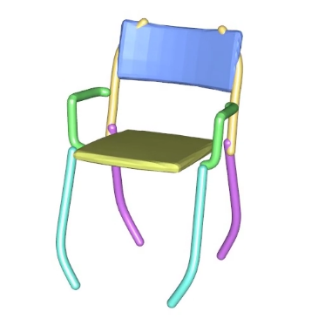
Our Proposal
The GeoTopo transform
Distortion Energy
Deformation model
Notes:
Our two key contributions are:
A deformation model that supports topological changes
And second, an energy that captures structural distortions, which we use to guide our correspondence search

Slide 15
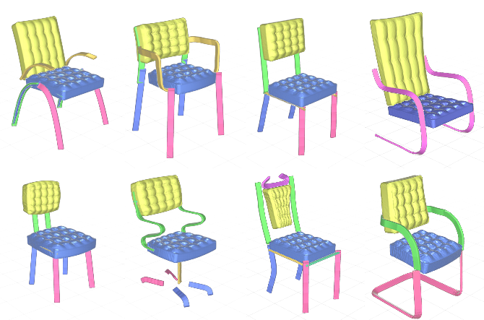
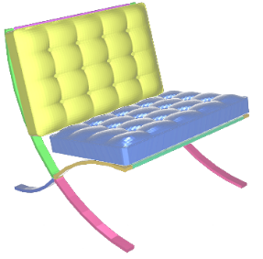
Deformation Model
Deformation suitable for man-made shapes
Simple deform-to-fit process + structure-preserving
Supports disconnected components
Topological changes
Notes:
Our proposed deformation model is suitable for man-made shapes
It is a simple deform-to-fit process, with structure-preservation,
It supports disconnected components
And it supports changes in topology, so we can also include one-to-many correspondences in our search

Slide 16
Distortion Energy
Structural self-distortion in three terms:
Distortion on all pairs of connected parts
Connectivity between parts
Solidity measure for parts changing topology
Notes:
Our proposed energy tries to encode structural distortions by considering three terms for a deforming shape:
The first is the parts distortion term, were we penalize large deviations in the original part arrangements
The second is a connectivity term, that favors assigning correspondences that keep connected parts close to each other
And the third is a solidity measure for parts changing topology, for example when a single part is expect to split into many

Slide 17
Correspondence Search
Search tree path: set of matched parts on the source
Beam search + pruning
leg front-leg front
seat-seat
back-back
leg back-leg back
3D shapes
Curve-sheet abstractions
back bar-back bar
Notes:
Given our deformation model and the distortion, we compute the best correspondence by expanding a search tree and looking for the best matching, which is the one with the least amount of energy
Each path to a leaf node represents a set of matches for all parts on the source to some parts on the target
The search space of possible assignments can grow exponentially
So, we apply a variant of beam search with some pruning rules to speed up the search

Slide 18
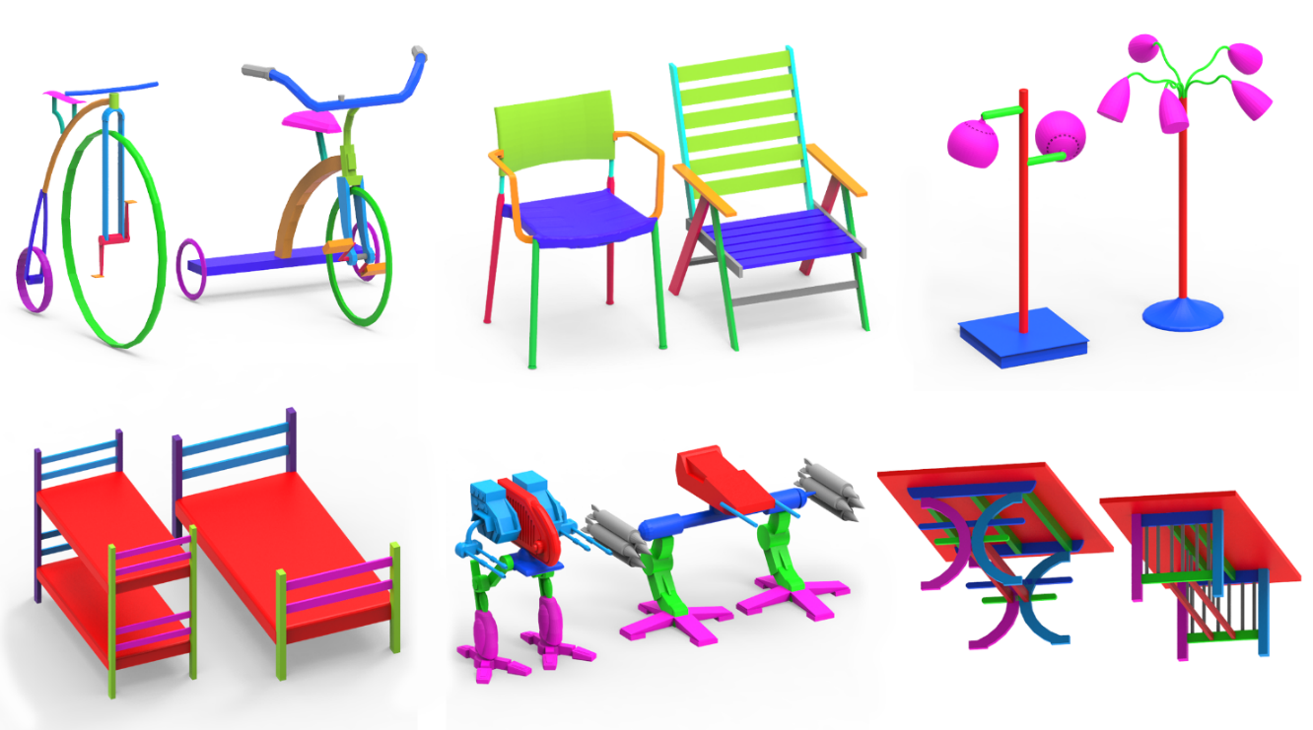
Results
Notes:
Here, we show some results obtained using our algorithm
Note the fine-grained part correspondences that have not been searched for in previous works, all found without supervision!

Slide 19
Results
Notes:
We see our method can work on different shape classes with many parts
We used the same settings on all of these results

Slide 20
Evaluation
Ground truth
75 shapes, 5 categories (chair, airplane, table, bed, velocipede)
Notes:
To quantitatively evaluate our performance, we created a labeled ground truth set of 75 complex shapes covering 5 categories

Slide 21
Evaluation
[Xu 12] Fuzzy part correspondence (baseline)
Works on pairs
Match based on part OBB similarity
[Zheng 14] Recurring part arrangements
Performs better than co-segmentation in the presence of large shape variability
[Kim 13] Deformable part-based templates
Better suited for large shape sets
Supports poorly segmented inputs
Notes:
We evaluated against three past methods:
The first is a baseline method, that supports shape pairs, and finely matches parts by comparing the similarity of their bounding boxes
The other two methods are recent co-analysis methods
One method uses the concept of recurring part arrangements, and the other is the deformable part-based templates that have been tested on large datasets and supports poorly segmented input models

Slide 22
Evaluation
Fine-grained correspondence benchmark
Notes:
This table shows the evaluation with the baseline method on fine-grained part correspondences
As we can see, our method outperforms the baseline in all categories in both the precision of the correspondences and its recall

Slide 23
Evaluation
Coarse correspondence benchmark (co-analysis)
Notes:
As for comparing with co-analysis methods, we used a coarse labeling of the ground truth
In this table we also see that we outperform all past methods on the coarse correspondence
More notably we achieve high relative accuracy for the table set and the bike set which exhibit complexity in terms of number of parts and how they connect to each other

Slide 24
Limitations
Initial segmentation
Large geo. and topo. differences
Notes:
Two main limitations that affect the quality of our results are:
the initial segmentation of the input shapes. We can see that the arms on one robot is only partially matched with the other since they are segmented into multiple segment on one but not the other
Second, our measure can still be greatly affected by large geometric and topological differences, for example, here we see that the wheels on the bike and tricycle models are not matched

Slide 25
Chapter. 4
Topology-Varying Shape Blending
Notes:
Our second major contribution is the development of a an algorithm for Topology-Varying Shape Blending

Slide 26
Previous Works
Shape creation from examples – replace or recombine parts
[Xu et al. 12]
[Jain et al. 12]
[Kalogerakis et al. 12]
[Zheng et al. 13]
Notes:
As I mentioned, recent efforts on shape creation from existing examples mainly applied recombination of compatible part
However, the expected output from these methods is quite limited, as they do not perform continuous blending

Slide 27
Shape Blending
Continuous, structure-aware blending of man-made 3D objects
Different transformations that morph source to target
morphing
splitting
appearing
Notes:
In this thesis, we propose the first continuous Shape Blending algorithm that is structure-aware and supports the morphing of shape pairs having different topology:
We need to define different transformation, or blending, operations that morphs the source to the target in a reasonable manner
Notice how in this example the legs are splitting, the top is morphing, and the side bar growing
The gradual transformation allows us to discover some interesting in-betweens!

Slide 28
Blending
one-to-none
one-to-many
one-to-one
Part correspondences
Notes:
To deal with part discrepancies, we support:
A one-to-one matching, which defines a simple part morphing
and add support to one-to-many and many-to-one matches, which define split and merge operations
and also allow one-to-nothing, which define a part grow and shrink operation

Slide 29
Blending
Each part is affected by a single “Blending operation“
A “Blending path” is an ordered set of blending operations
MORPH
GROW
SHRINK
SPLIT
MERGE
Notes:
Each part is only affected by a single blending operation,
We define a “Blending path”, which is an ordered set of blending operations
reordering of the blending operations results in different in-betweens, allowing for many variations

Slide 30
Results
Dataset – 110 man-made objects
furniture, airplanes, robots, etc.
896 synthesized shapes can be found at project page
Interesting results are selected by the user
Notes:
We’ve tested our method on a set of 110 man-made objects with rich topological and structural variation
We were able to synthesize many shape variations, of which users selected the most interesting ones. These can be found at our project page

Slide 31
Results
Notes:
Here we see some results,
Some of the generated in-betweens are similar to ones generated via part replacement, as in robot models
While others are simply not possible without the blending of both the geometry and connectivity of the parts as seen in these beds

Slide 32
Results
Notes:
Here are some more results

Slide 33
Comparison
Volumetric morphing vs. our continuous blending
[ours] [volume morphing]
Notes:
Here we compare against state-of-the-art volumetric morphing approaches, note how the results can be broken and parts distorted
We can see our blending, shown in blue, produces more plausible results

Slide 34
Plausibility
Plausibility of the generated shapes
Highly dependent on the compatibility of the input shapes
Relates to non-geometric factors: preserved functionality, meaningful part proportions, physical stability, style coherence
Our method merely provides a way to generate shapes
Notes:
An important issue that is yet to be addressed is the level of plausibility of the generated shapes
First, it can be highly dependent on the compatibility of the input shapes, think office chair and beach chair
Second, it can relate to different factors including preserved functionality, meaningful part proportions, physical stability, overall style coherence
Our method so far only provides a way to generate continuous blends, and therefore, we leave the evaluation of the plausibility of the generated shapes to the user

Slide 35
Chapter. 5
Tools for Shape Creation
and Exploration
Notes:
Now lets briefly look at the final contribution of this thesis
A set of Tools for Shape Creation and Exploration

Slide 36
Shape Creation Tools
github.com/ialhashim/TopoBlender
TopoBlender
Notes:
We developed an easy-to-use interactive modeling system we call "TopoBlender“
This system contains several modeling tools that use our 3D shape matching and blending techniques

Slide 37
Tools
Manual blending
Two-to-one merge
Morph legs
Other morphs
Notes:
The first tool is a user-controlled "Manual blending":
We provide the user with an interface in which the user specifies different blending ratios on different parts of the shape
Here we see several examples where the user apply successive editing to model a new shape

Slide 38
Tools
Structure transfer
Notes:
Another tool is the "Structure transfer" tool where structural attributes including part cardinality and placement are transferred between shapes
The user simply selects the target shape and the system deforms the source geometry to match the selected target guided by our shape matching algorithm

Slide 39
Tools
Shape exploration
Notes:
The final tool is the Shape Exploration tool that combines both exploration and direct synthesis
Here we present the user with the set of chairs embedded into a 2D space using the pair-wise correspondence costs

Slide 40
Tools
Shape exploration
Notes:
And the user can then explore in-betweens by clicking a point in this space and the system computes an interpolated shape
As discussed in the thesis, this embedding has the potential for clustering structurally similar shapes allowing for a more meaningful exploration

Slide 41
Chapter. 6
Conclusion and Future Work
Notes:
To conclude, in this thesis we proposed a new framework for the matching and modeling of man-made objects.

Slide 42
Conclusion
Topology-changing deformations for correspondence and shape creation:
A continuous, fine-grained part matching algorithm
Designed a topology-varying shape blending mechanism
User-controlled and automatic intuitive modeling tools
Our proposed framework shows promising results with much room for improvements!
Notes:
We define how to evaluate and perform: topology-changing deformations for the problems of correspondence and shape creation
We (1) developed a continuous fine-grained matching algorithm and (2) designed a topology-varying shape blending mechanism that can be used in (3) user-controlled and automatic synthesis using intuitive modeling tools
Our proposed framework shows promising results with much room for improvements!
There is a lot to do in the future to improve both accuracy of fine-grained correspondence, and plausibility of interpolated shapes

Slide 43
Future Work
Representation
Volumetric-based representation for more complicated structures
Segmentation
Online shape repositories are not well segmented
Incorporate a segmentation search with the correspondence search
High energy
Low energy segmentation
Notes:
One avenue for future work is on the Representation side: Our shape abstraction can represent only a subset of man-made shapes decomposable into cylindrical or board-like parts. Other types of abstractions are needed, perhaps a volumetric-based one
On the Segmentation problem: large shape repositories are typically not well segmented. A possible way to go about this is to incorporate a segmentation search in the correspondence process. Here we show an example in which different segmentations resulted in different deformation-energy. We can see that some segmentation options result in a lower energy, therefore, they can define good candidates for segmentation

Slide 44
Future Work
Plausibility of outputs?
Data-driven approach
Compare visual similarity, or other measures, with the database
Incorporating functionality analysis
Notes:
Regarding Plausibility: as is the case with existing methods for shape synthesis from, there are no easy ways to guarantee plausible synthesized shapes
To address these issues, it seem that a data-driven approach is well suited in which the generated shape's plausibility, for example in terms of visual similarity or functionality analysis, could be evaluated against a large set of existing shapes of the same class. A plausibility score might also help in finding the more reasonable blending paths.

Slide 45
Future Work
Other directions
Shape extrapolation (i.e., going beyond interpolation)
Learning parametric models and shape class structure or part styles from a set in order to synthesize entirely novel shapes
Notes:
Other directions also include:
Shape extrapolation (i.e., going beyond interpolation),
And also, Learning parametric models and shape class structure or part styles from a set in order to synthesize entirely novel shapes

Slide 46
Acknowledgments
My co-authors
Richard, Kevin, Howard, JJ, Ethan, Rui, and Patricio
Supervisory committee
My family and friends
Thank you!
Notes:
And with that, I conclude my thesis summary.
I would like to thank my colleagues who have helped me on the two publications which are part of this thesis:
They are my supervisor Richard, and my other collaborators Kevin, Howard, JJ, Ethan, Rui, and Patricio.
And I'd like to also thank the members of my thesis committee for all their comments and suggestions
And for everyone here taking the time to attend my talk. Thank you.

Slide 47
Questions?

