Slide 2
Topology-Varying 3D Shape Creation via Structural Blending
Ibraheem Alhashim Honghua Li Kai Xu
Junjie Cao Rui Ma Hao Zhang
Presenter: Ibraheem Alhashim
Simon Fraser University
Notes:
Hello everyone!
Today I’ll present our system for 3D shape creation by continuous blending of different shapes

Slide 3
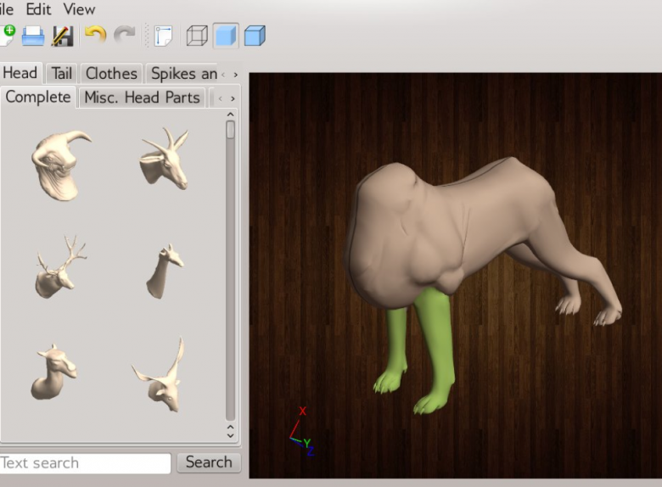
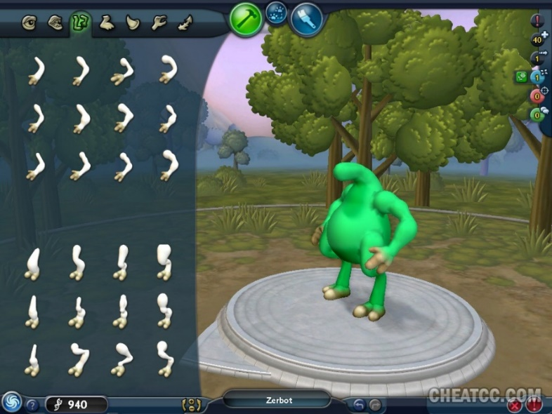
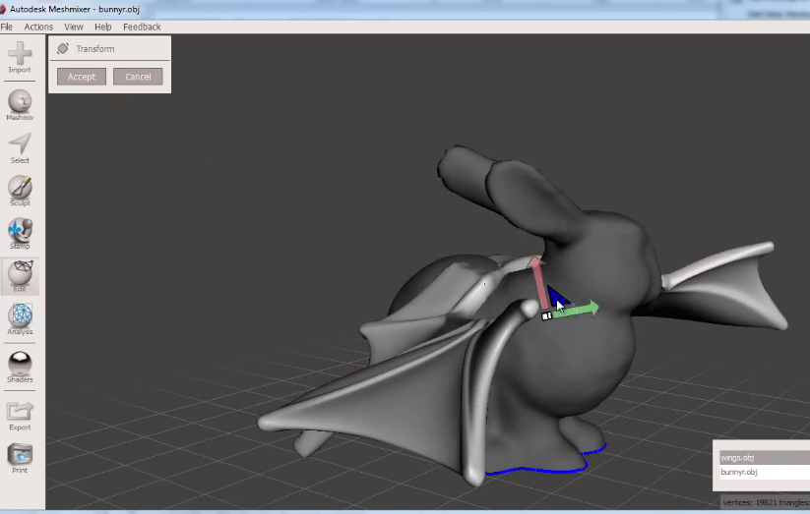
Blending-Based Model Creation
Mixing existing parts for shape creation
[Chaudhuri 11]
[Maxis Spore 08]
[Autodesk Meshmixer 14]
Notes:
Manual mixing of parts from different objects is a well established modeling technique especially for novice users [CLICK!]
There are many recent examples found in both academia and commercial software such as Autodesk’s Meshmixer

Slide 4
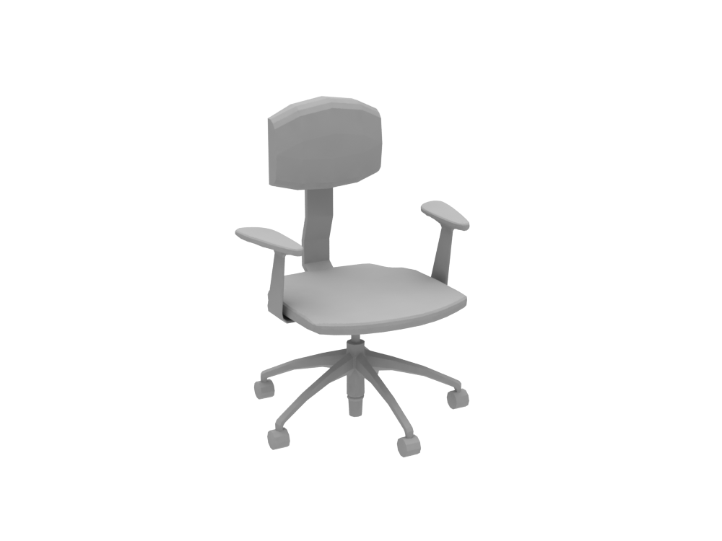
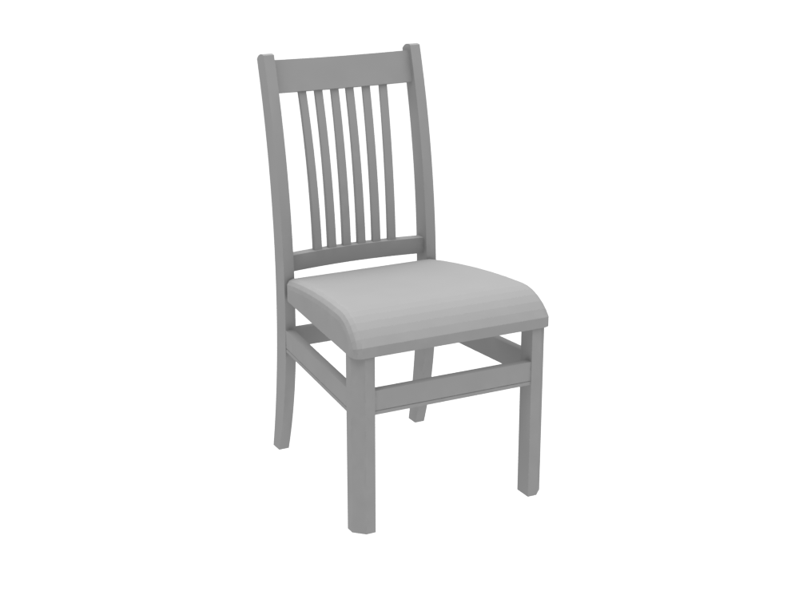
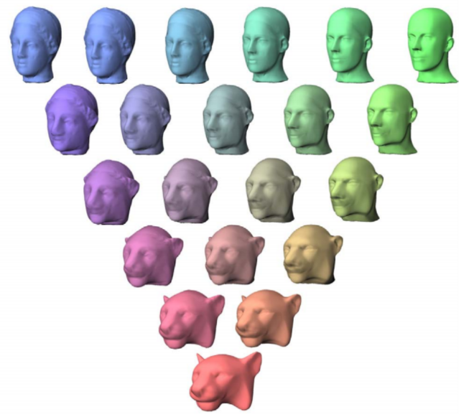
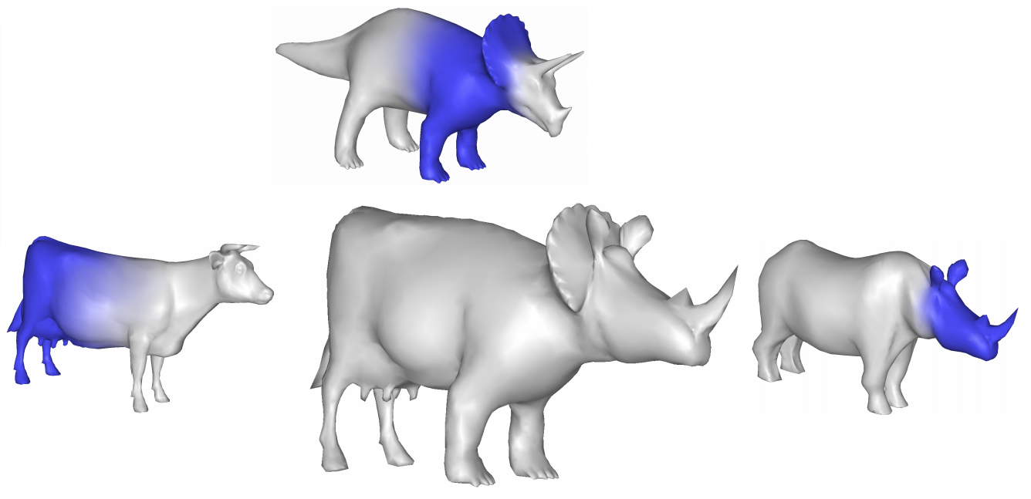
Blending-Based Model Creation
Continuous boundary based shape interpolation
?
[Alexa 02]
[Michikawa 01]
[Kraevoy et al. 04]
Notes:
Rather than pasting parts together [CLICK!]
we can utilize continuous shape interpolation for modeling by blending from a pair or more of existing shapes
the main issue however is the requirement for an exact mappings
So [CLICK!] for shapes with large geometric dissimilarity and different structure it is not possible to apply these methods!

Slide 5
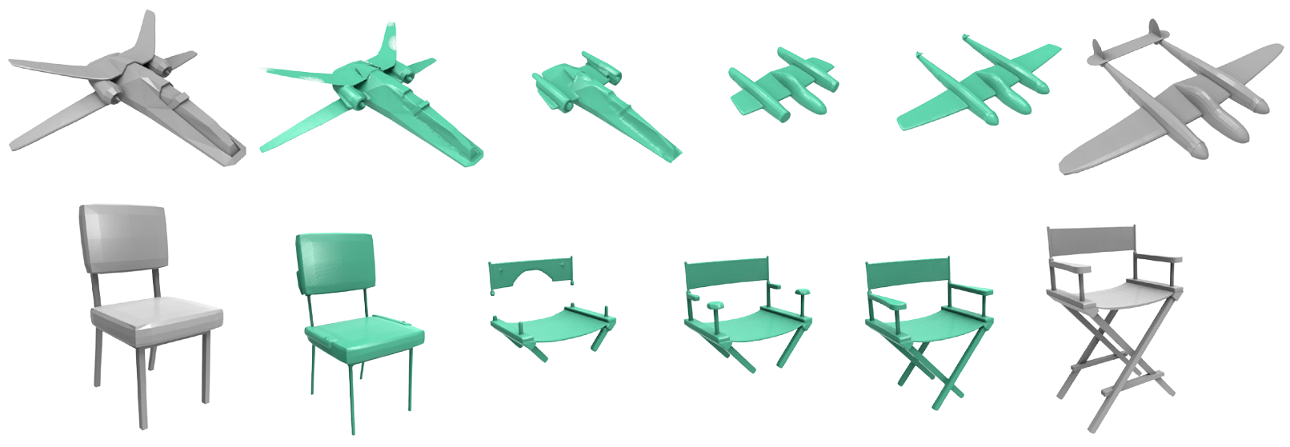
Blending-Based Model Creation
Volumetric based interpolation allows different topology
[Breen & Whitaker 01]
Notes:
an obvious solution would be to look at shape interpolation methods that allow for topological changes between the input pairs [CLICK!]
This volumetric based interpolation is one example
But we can see the in-between are disconnected and distorted and aren’t really usable..

Slide 6
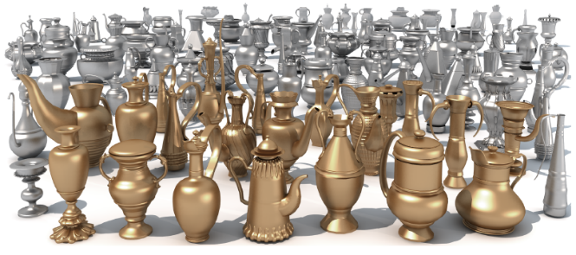
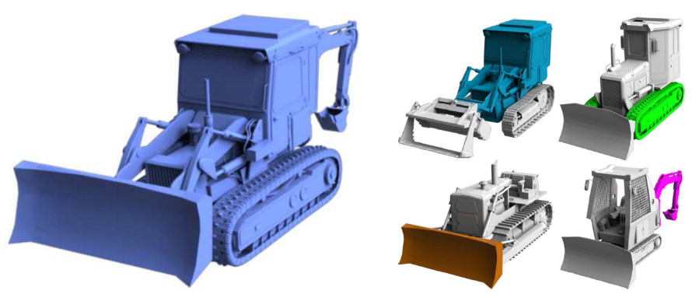
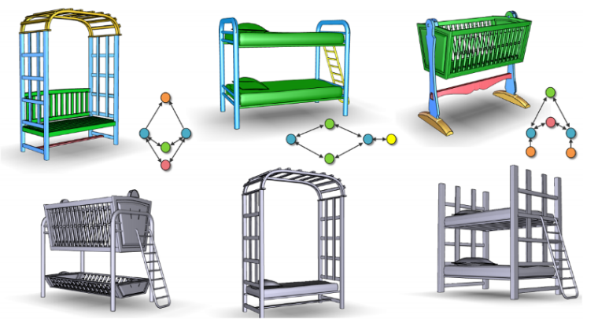
Part Composition
Automatic part replacement and recombination
[Xu et al. 12]
[Jain et al. 12]
[Kalogerakis et al. 12]
[Zheng et al. 13]
Notes:
[CLICK!]
So until now people have been focused on part-based composition for shape modeling [CLICK!]
Many automatic or semi-automatic methods proposed can produce many varieties from shape repositories
They often try to replace compatible parts, where compatibility is determined by geometric or structural properties

Slide 7
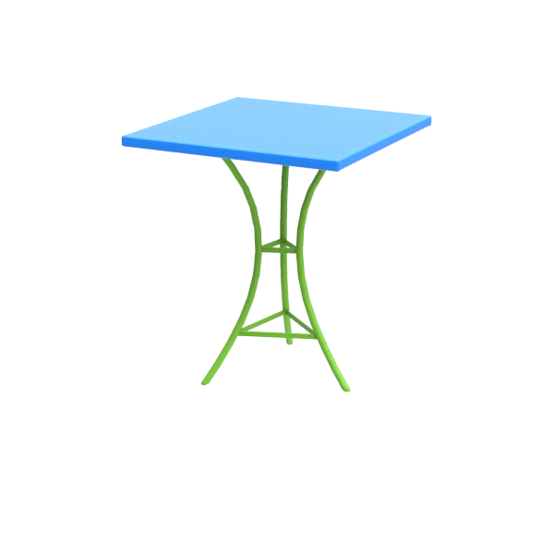
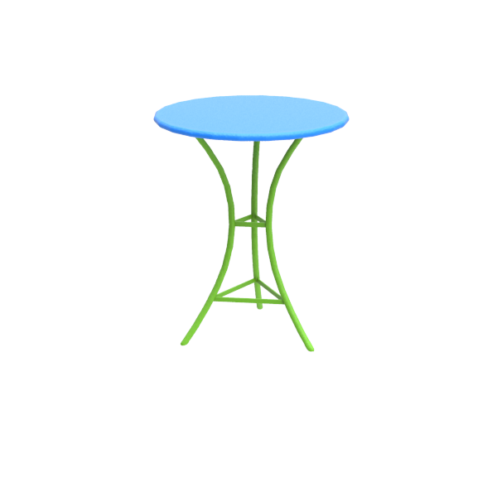
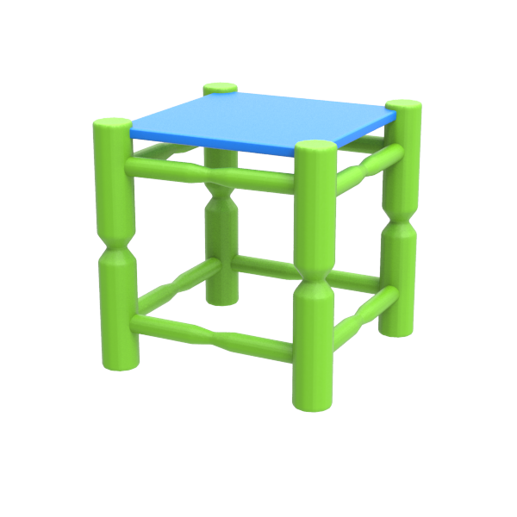
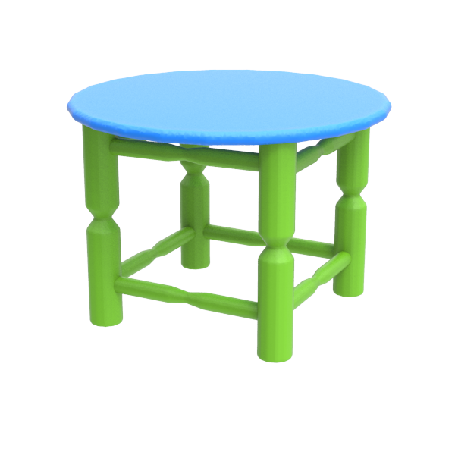
Part Composition
Limited number of possible blends
Notes:
The problem with part composition approaches is that they tend to generate a limited number of possible blends
Here we see a three and four legged tables only generating two new shapes 2X [CLICK!] [CLICK!]
In this work, we argue that we can produce even more than that
In fact! we would like a continuous transition from one shape to the other

Slide 8
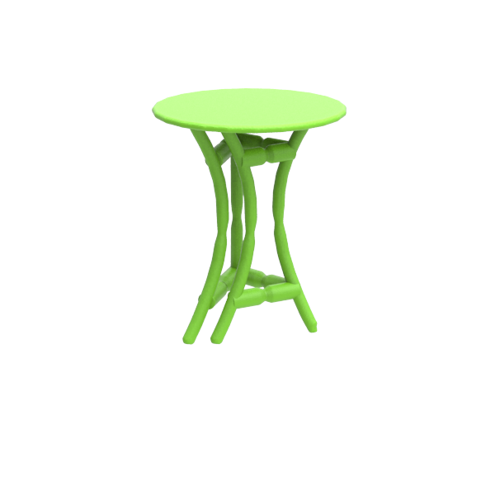
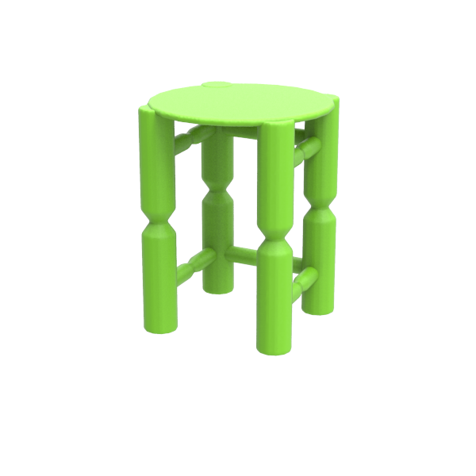
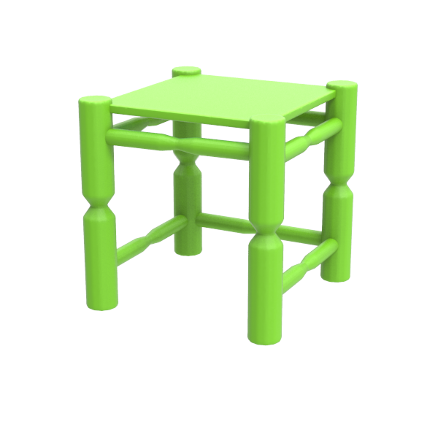
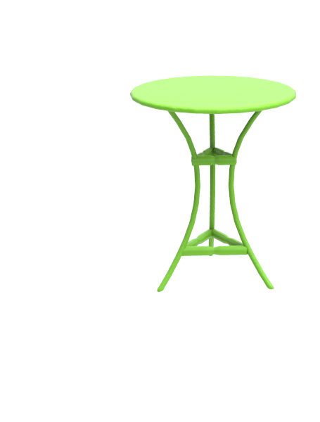
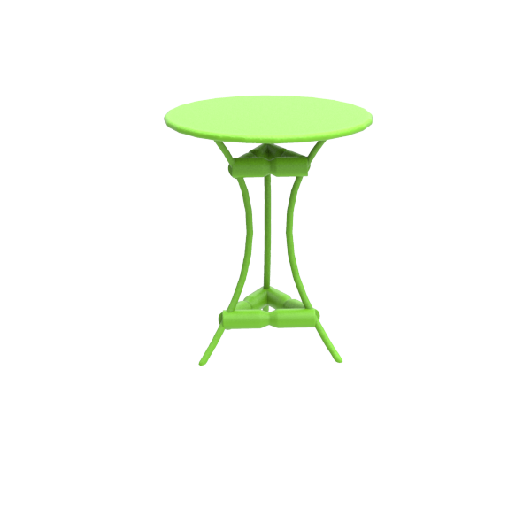
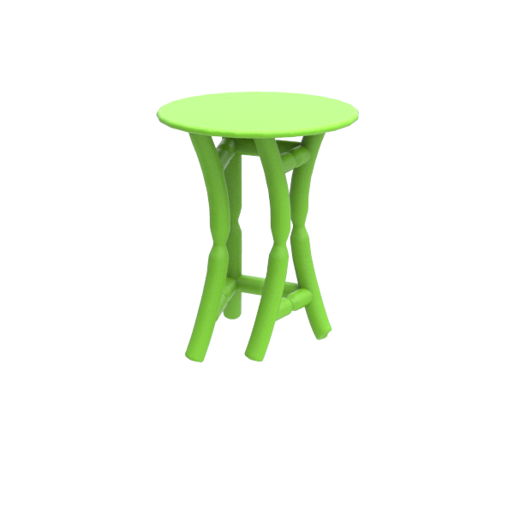
Continuous Shape Blending
Blending on both geometry and topology
morphing
splitting
appearing
Notes:
Here we see in action our main contribution of blending on both geometry and topology [CLICK!]
Notice how the legs are splitting, [CLICK!]
the top morphing, [CLICK!]
and the side bar growing [CLICK!]
The gradual transformation allows us to discover some interesting in-betweens!

Slide 9
Technical Challenges
Representation level
Surfaces – tracking topology changes hard!
Volumes – difficulty in encoding structure & more involved
Correspondence and interpolation
Parts split, no equivalent parts, geometric dissimilarity…
?
Notes:
I’ll now describe two major technical challenges faced in this problem
The first is the presentation level, tracking topology changes using surface representation is very difficult!
As we saw, volumes are able to do so but we are faced with challenge of preserving the integrity of the shape
The second challenge is deciding on the part correspondence between parts of very different shapes
We need to consider that parts might split, have no equivalent, and are very different in proportions

Slide 10
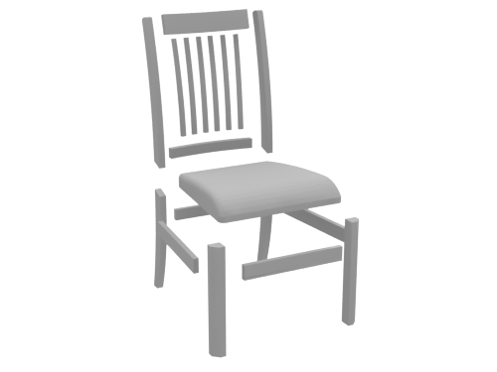
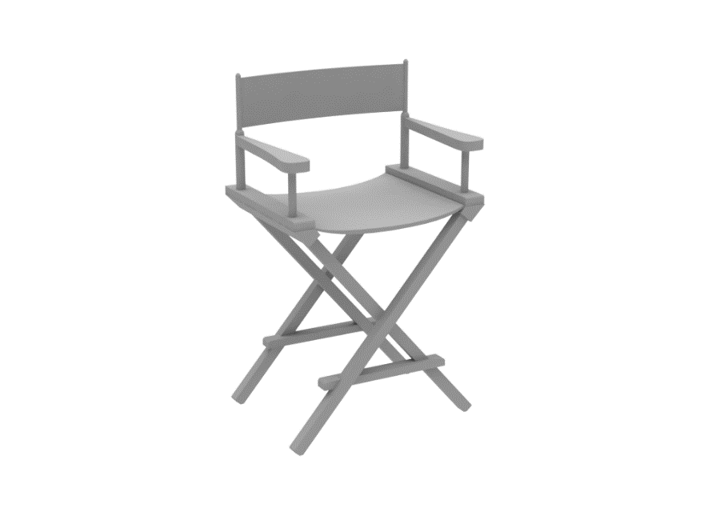
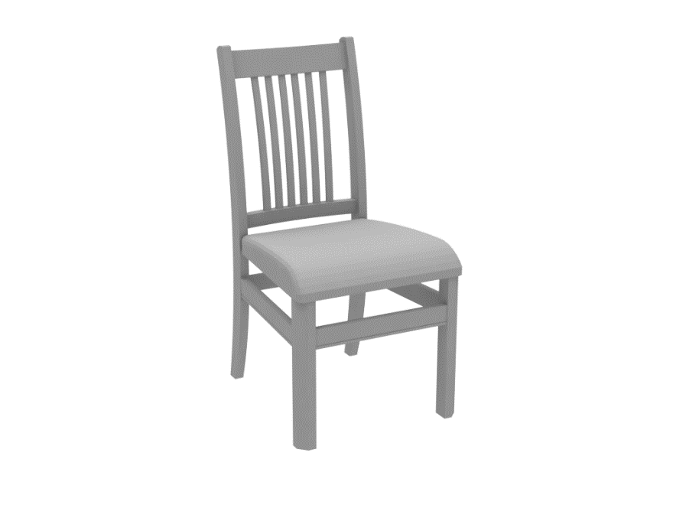
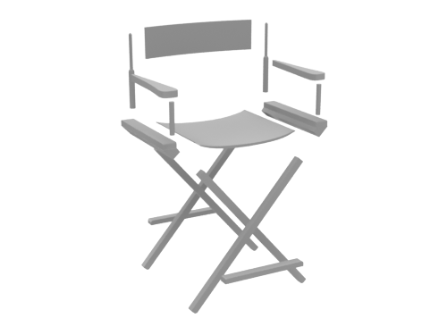
Our Solution
Representation
Notes:
So we took a shot at it and came up with this work as a first solution
First we will assume that the inputs are composed of segmented watertight parts

Slide 11
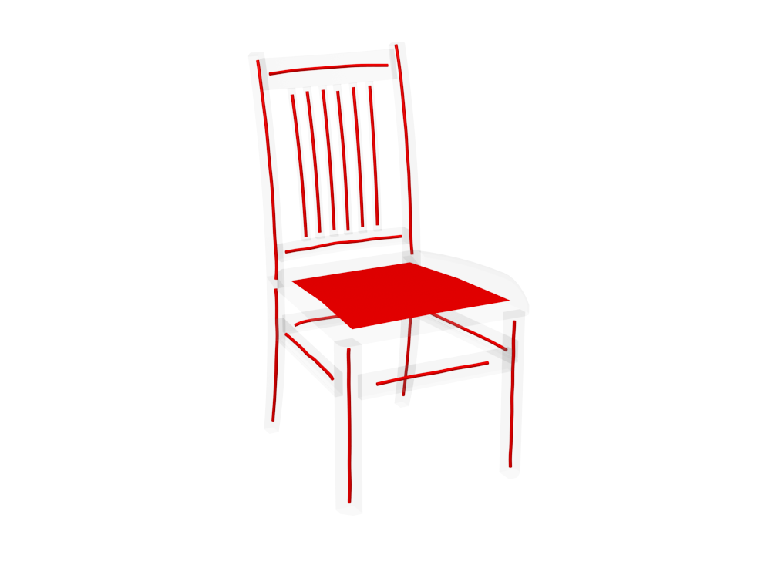
Our Solution
Representation
Curve + sheet part abstractions – easy to work with!
Topological changes are more straightforward
[Tagliasacchi 12]
Notes:
The parts are abstracted by fitted curves and sheets resulting from skeletonization
These abstractions have the advantage of
Simplicity to work with as opposed to the original surfaces
Simplify carrying out topological changes
Simplify the discovery and encoding of part relations

Slide 12
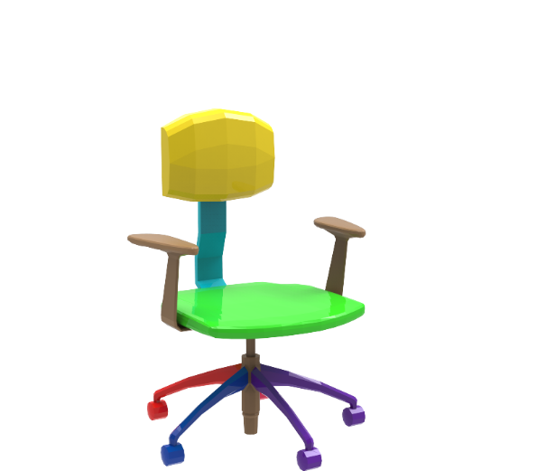
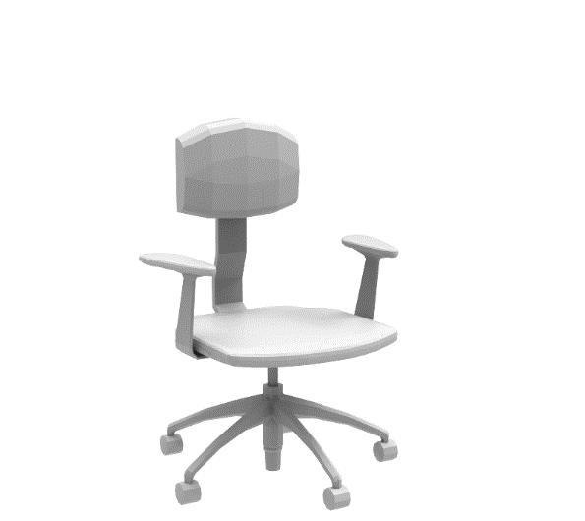
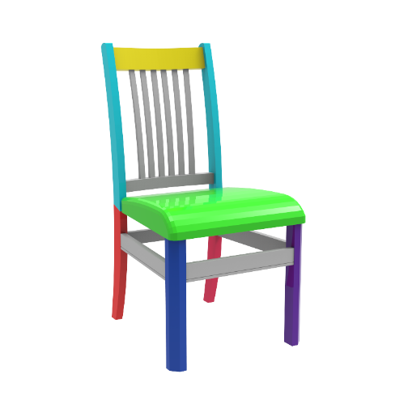
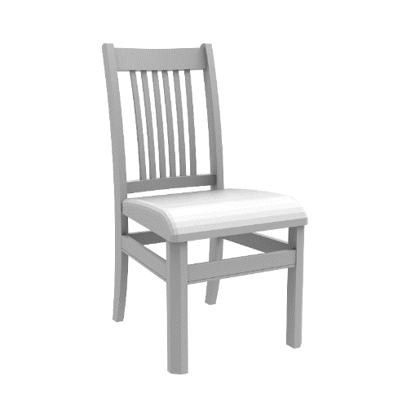
Our Solution
Representation
Curve + sheet part abstractions – easy to work with!
Topological changes are more straightforward
Correspondence and interpolation
Allow parts to correspond to many or even no other part
Part blending is structure-aware and continuous
Notes:
For tackling the second challenge [CLICK!]
we allow different types of part correspondences
And so parts may or may not have one or more corresponding parts [CLICK!]
[CLICK!] Plus, we apply all our per-part blending operations in a continuous manner. This lets us explore variability while helping preserve part relations during the entire blend

Slide 13
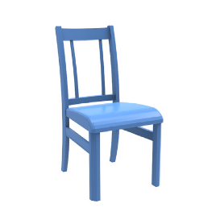
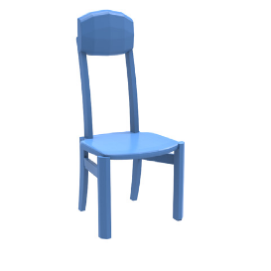
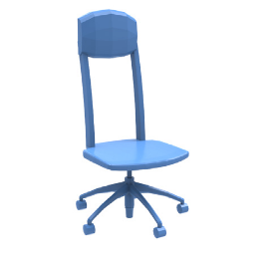
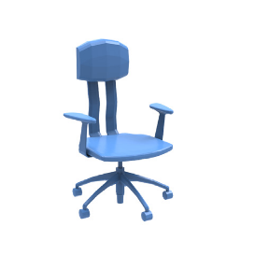
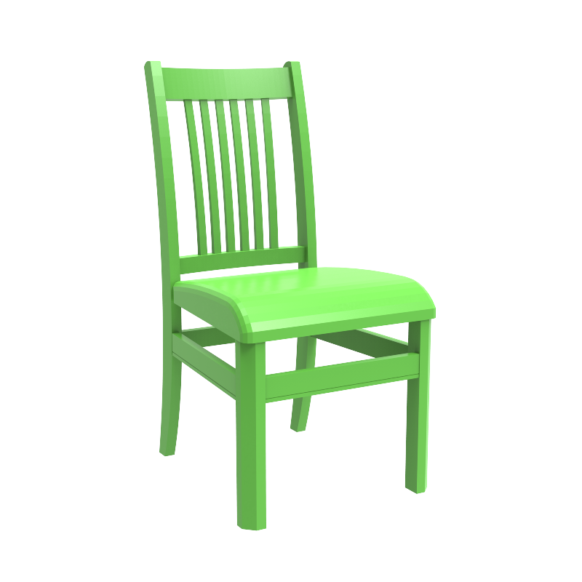
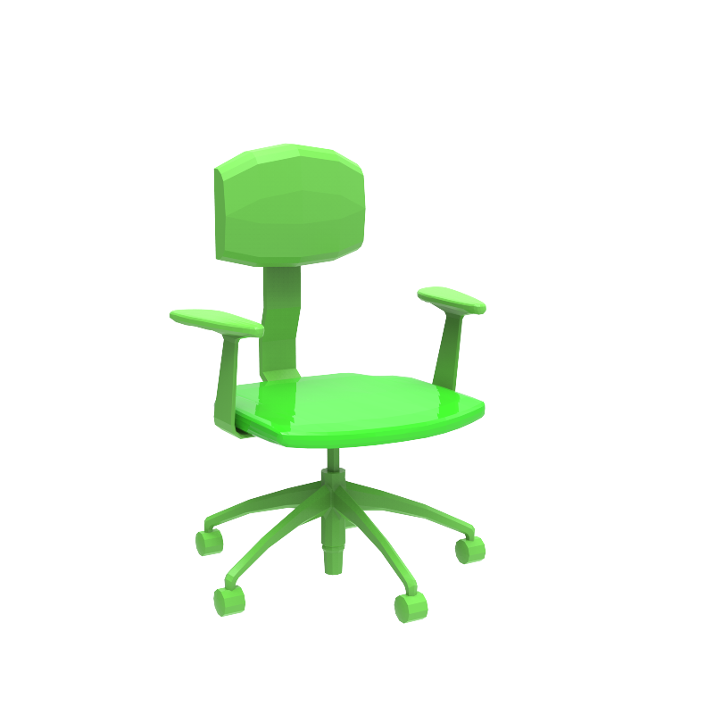
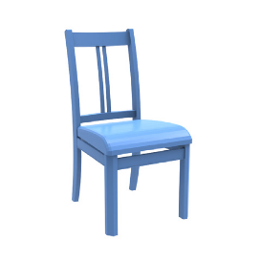
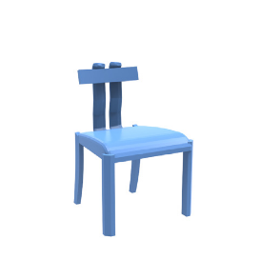
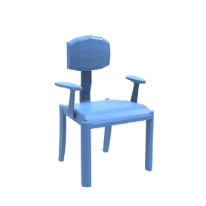
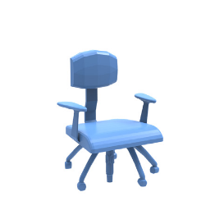
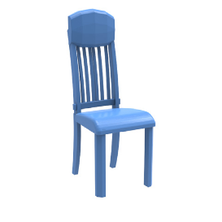
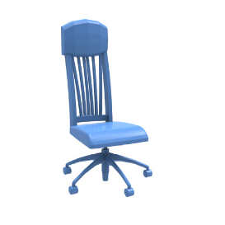
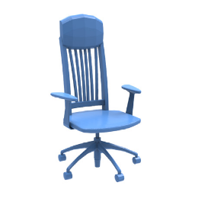
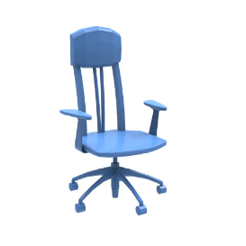
Our Solution
topology changes!!
Continuous shape blending
…
…
…
…
…
…
…
…
…
…
…
…
novel shapes!
Notes:
Following these main ideas, our solution can generate a large number of continuous blending transformations
This results in interesting [CLICK!] topology changes and helps users discover [CLICK!] novel shapes as seen here

Slide 14
Pipeline
one-to-none
one-to-many
one-to-one
Define part correspondences
Notes:
There are three major steps in our pipeline.
The first is defining part correspondences. We allow three types of correspondences:
one-to-one shown here for the backs
one-to-many as seen here for the vertical bars in blue
and for parts with no equivalent we define one-to-none or in this case many-to-none for the two armrest parts

Slide 15
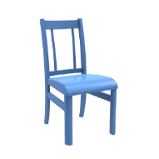
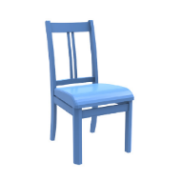
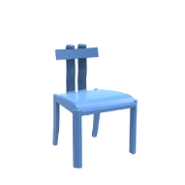
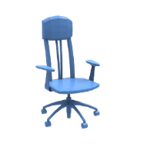
Pipeline
Define part correspondences
Generate blending paths
Notes:
With the defined correspondences we now generate many sets of blending paths that transform the different parts of one shape to the other
Which is done by changing the ordering of the defined blending operations on each part

Slide 16
Pipeline
Define part correspondences
Generate blending paths
Filter clearly implausible results
Notes:
The last step is a basic filtering step [CLICK!] that discards clearly implausible results

Slide 17
Blending Operations
Each part is assigned an operation
Continuous transformation from source to target
Related to the type of assigned correspondences
MORPH
GROW
SHRINK
SPLIT
MERGE
Notes:
Our blending process is carried out as a set of blending operations
Each part is assigned a blending operation
Continuous transformation from source to target
They are related to the assigned correspondences
The operations include : morphing, growing, shrinking, splitting, and merging

Slide 18
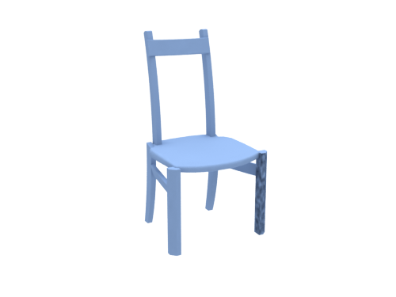
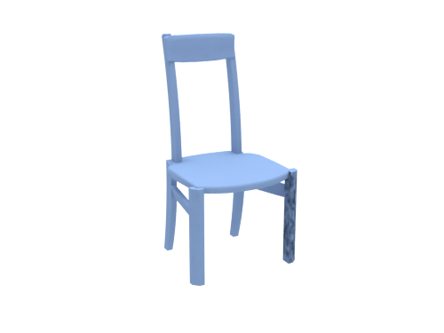
Blending Operations
One-to-one: morphing
Notes:
The blending operations [CLICK!] include part morphing, [CLICK!] for one-to-one correspondences

Slide 19
Blending Operations
One-to-many: splitting / merging
Notes:
Part splitting or merging [CLICK!] for one-to-many correspondences, applied here to the back vertical bars

Slide 20
Blending Operations
One-to-none: shrinking / growing
Notes:
and part growing or shrinking for parts on one shape that do not have a compatible equivalent on the other

Slide 21
Blending Paths
Blending path – a permutation of the set of blending operations
Variability in blending by reordering
Notes:
A blending path is a permutation of the set of blending operations assigned
The variability of the generated paths is a result of the reordering of the blending operations

Slide 22
Structure Preservation
Operations are applied with structure in mind
Symmetry relations, local and global
Part contacts
Notes:
Each path executes the blending operations while keeping the original structural relations in mind
These relations include symmetry both local and global, and part contacts
We can see that the side parts of the beds are changing together which preserves global symmetry

Slide 23
Filtering
Filter out obviously bad results
Global reflection symmetry
Part group symmetry
Part connectivity
Purely geometric..
Notes:
the input pairs do not necessarily share the general structure, so it is likely that we produce implausible shapes
And so we apply a filtering that is based on measuring the extent of preserved global and local relations, including symmetry relations and part contact
This filtering is purely geometrical, it does not guarantee good plausibility nor it is useful to discover interesting new shapes
These things are still limited to human judgment

Slide 24
Exploratory Modeling Tool
FAST!
Intuitive!
Code available!
Notes:
And so we developed an intuitive exploratory tool that facilitate the creation of new shapes through our topology changing blending process [CLICK!]
The tool is very intuitive to use and it is quite fast!

Slide 25
Exploratory Modeling Tool
Notes:
Our tool makes it easier for users to navigate the space of possible in betweens
The user starts by selecting a pair of input shapes from a dataset
A correspondence is computed automatically at first, and typically a couple of mouse clicks are needed to correct invalid correspondences
The tool then generates many blending paths and sample a few representative in-betweens of each path
Users can explore the continuous paths by clicking between two consecutive in-betweens as we see here
The synthesis process is quite efficient and can be computed in parallel
A typical blending session with shapes having around 12 parts, would need less than 10 seconds
In-betweens are readily available for subsequent shape blending as seen with this synthesized table model

Slide 26
Exploratory Modeling Tool
Source code + demo + data
gruvi.cs.sfu.ca/project/topo

Slide 27
Results
Notes:
We can see some of the generated in-betweens are similar to ones generated via part replacement, as in some of robot models
While other shapes are simply not possible without the blending of both the geometry and connectivity of the parts as seen in these beds

Slide 28
Results
Notes:
Here we see blending of a pair of bench models and desk lamps

Slide 29
Results
Kitbashing !
Notes:
Here are models that are not related to chairs!
I’ve had some feedback about how are method might be useful in the kitbashing community

Slide 30
Evaluation
Part replacement vs. continuous blending
[ours] [set evolution]
Notes:
[CLICK!] It’s tough to fairly evaluate our approach with existing discrete shape creation by part recombination [CLICK!]
So what we did is try to evaluate the quality and variability of the produced outputs, and here is an example that shows that continuous blending can generate a bit more variable and natural in-betweens

Slide 31
Evaluation
Volumetric morphing vs. continuous blending
[ours] [volume morphing]
Notes:
And coming back to volumetric approaches, we noted how results can be broken and parts distorted when blending structured objects
We can see how our blending, shown in blue, produces more plausible results

Slide 32
Evaluation
Volumetric morphing vs. continuous blending
[ours] [volume morphing]
Notes:
Here is another examples..

Slide 33
Results
Recursive blending
Notes:
[CLICK!] We’ve also tried to apply our shape blending recursively [CLICK!]
One avenue for future work is to try to apply blending across a larger collection of shapes together rather than on shape pairs

Slide 34
Results
Dataset – 110 man-made objects
furniture, airplanes, robots, etc.
Supplementary material – 896 synthesized shapes
visit project page
Notes:
We’ve tested our method on a set of 110 man-made objects with rich topological and structural variation
The entire dataset and more results can be found on our project page

Slide 35
Conclusion
3D model creation via continuous shape blending
First to consider topology + geometry with a structure-aware representation
Developed an intuitive tool to help explore continuous space
Notes:
To conclude,
We have presented a 3D model creation system based on continuous shape blending
First to consider topology and geometry by utilizing a structure-aware representation
To better help users explore the space of possible in-betweens, we’ve developed an intuitive tool that efficiently generates these continuous blending path

Slide 36
Conclusion
3D model creation via continuous shape blending
First to consider topology + geometry with a structure-aware representation
Developed an intuitive tool to help explore continuous space
Previous – Rigid transformation of parts
Current – Interpolation of geometry + structure + part connectivity
Notes:
To summarize our work,
While previous works only apply rigid transformations in part composition
We’ve shown that interpolation of ‘geometry’, ‘structure’, and ‘part connectivity’ generates much more variability!

Slide 37
Challenges
Topological complexity
[Breen & Whitaker 01]
Notes:
As a first step, our method is still limited in many ways
The main challenge is the level of topological complexity that is applicable to our method
Complex shapes like the following two shapes, shown in grey, are not easily abstracted using our strategy
And we can see that volumetric based interpolation could produce reasonable in-betweens

Slide 38
Challenges
Topological complexity
Plausibility
functionality, proportions and physical stability
Notes:
The other challenge is evaluating the plausibility of the results
Right now we relay on the user to explore and select usable in-betweens
No checking for preserved functionality, proportions, and physical stability is performed

Slide 39
Future Work
Hybrid skeletal/volumetric representation
Evaluating the functional plausibility of synthesized objects
Cross-category shape blending
Notes:
And from these challenges we can think about future avenues for this work
The first is defining a more flexible representation to allow for more complex topology, maybe a hybrid skeletal and volumetric representation is appropriate
The second avenue is thinking about evaluating the functional plausibility of the synthesized object.
This is essential for both finding good correspondences automatically, and for filtering out broken shapes
Cross-category shape blending is another avenue for future work, blending without the restrictions of learning specific templates but by simply finding reasonable correspondence

Slide 40
Thank you!
gruvi.cs.sfu.ca/project/topo
ACKNOWLEDGMENTS
Anonymous reviewers & funding from
NSF China, CPSF, CSC
Notes:
Finally, [CLICK!]
I encourage you to try our tool found at our project page
I’d like to thank the anonymous reviewers for their suggestions and our funding agencies
And thank you for listening!

